Slide 1
Introduction to CUDA – A Workshop
Shehzan Mohammed
Lecturer, CIS 565 – GPU Programming & Architecture
University of Pennsylvania

Slide 2
Today We’ll Learn
Intro to CUDA
Thread Hierarchy
Memory Model
Warps, Thread Scheduling, Synchronization
CUDA Examples:
Vector Addition
Matrix Multiply
CUDA Libraries

Slide 3
Prerequisites
You (probably) need experience with C or C++
Experience with pointers is even better
You don’t need GPU experience
You don’t need parallel programming experience
You don’t need graphics experience

Slide 4
What is CUDA
CUDA Architecture
Expose GPU parallelism for general-purpose computing
Retain performance
CUDA C/C++
Based on standard C/C++
Small set of extensions to enable heterogenous programing
Straightforward APIs to manage devices, memory, etc.

Slide 5
GPU Computing History: APIs
2001/2002 – researchers see GPU as data-parallel coprocessor
The GPGPU field is born
2007 – NVIDIA releases CUDA
CUDA – Compute Uniform Device Architecture
GPGPU shifts to GPU Computing
2008 – Khronos releases OpenCL specification
2013 – Khronos releases OpenGL compute shaders
2015 – Khronos releases Vulkan and SPIR-V
Notes:
Compute shaders have been in Direct3D for a while.
WebCL never caught on.

Slide 6
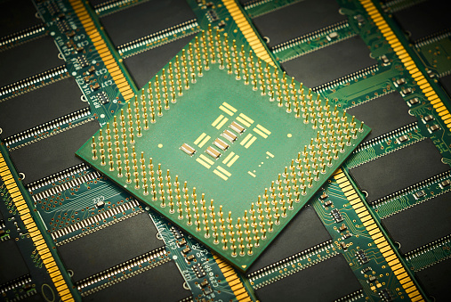
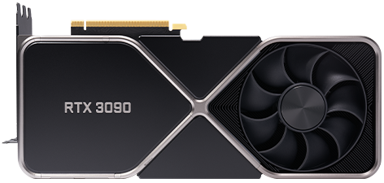
Heterogenous Computing - Terminology
Host: typically, the CPU
Code written in C/C++ (or other languages)
Device: typically, the GPU (data-parallel)
Code written in extended C/C++
Host and device have separate memories
Except for SoC
CUDA Program
Contains both host and device code
Host
Device

Slide 7
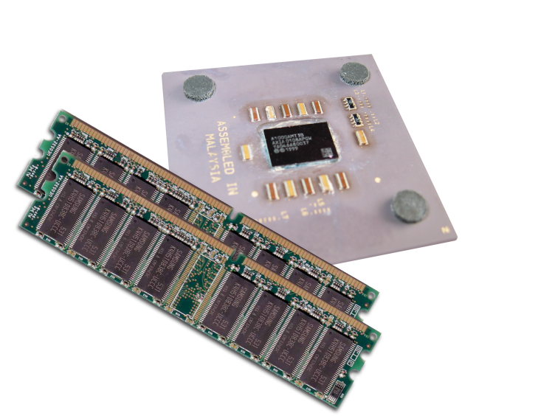
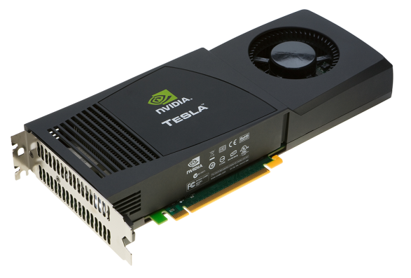
Heterogenous Computing - Terminology
Kernel: data parallel function
Invoking a kernel creates lightweight threads on the device
Threads are generated and scheduled with hardware
Serial Code
Parallel Code
Serial Code

Slide 8
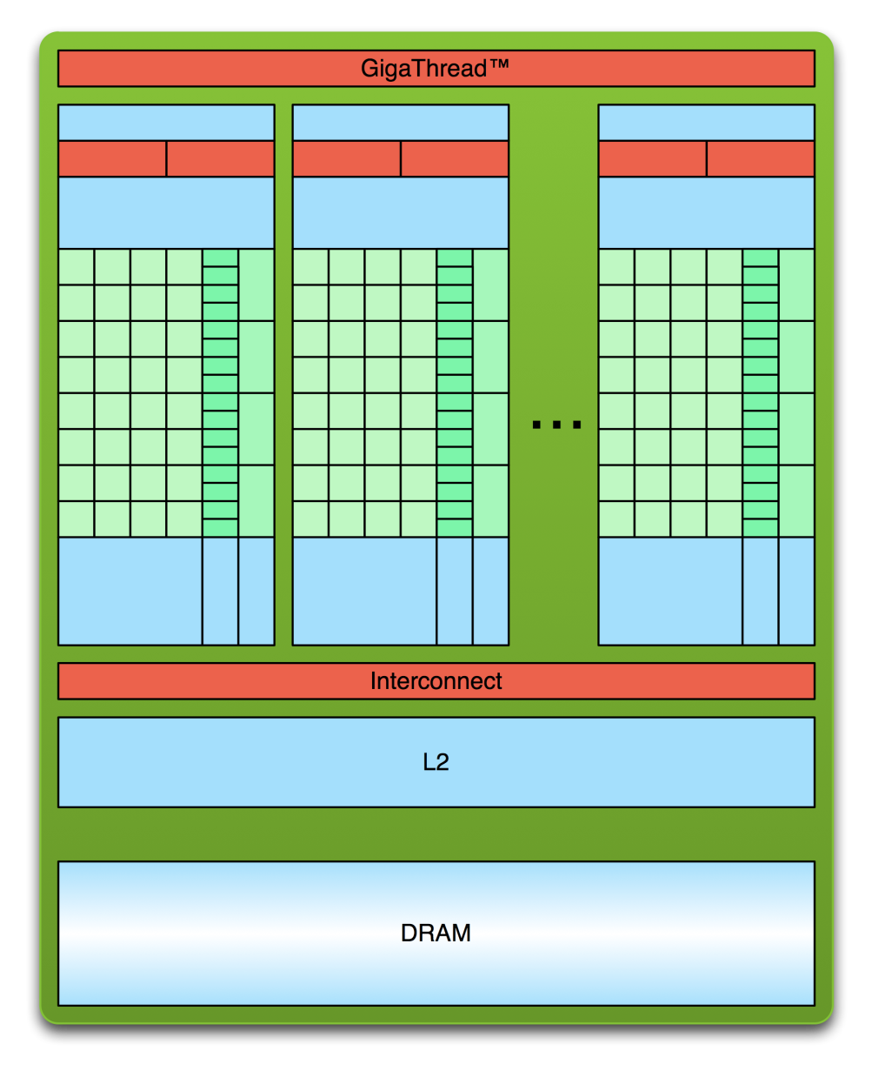
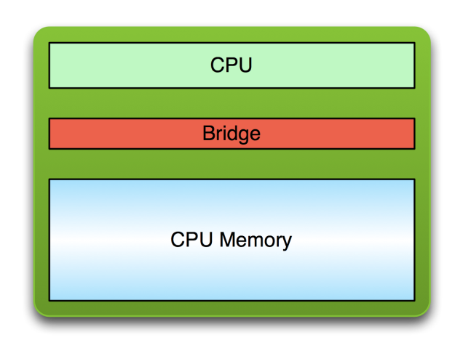
Simple Processing Flow
PCI Bus
Copy input data from CPU memory to GPU memory

Slide 9
Simple Processing Flow
PCI Bus
Copy input data from CPU memory to GPU memory
Load GPU program and execute, caching data on chip for performance

Slide 10
Simple Processing Flow
PCI Bus
Copy input data from CPU memory to GPU memory
Load GPU program and execute, caching data on chip for performance
Copy results from GPU memory to CPU memory

Slide 11
CUDA Kernels
Executed N times in parallel by N different CUDA threads
Declaration specifier
// Kernel Definition
__global__ void vectorAdd(const float* A, const float* B, float* C)
{
int i = threadIdx.x;
C[i] = A[i] + B[i];
}
int main()
{
// ....
// Kernel invocation with N threads
vectorAdd<<<1, N>>>(A, B, C);
}
Thread Index
Kernel execution configuration
Notes:
threadIdx is a 3-component vector

Slide 12
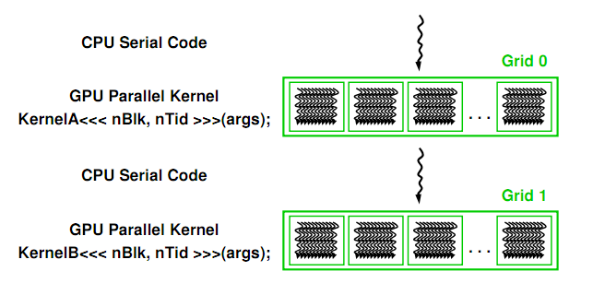
CUDA Program Execution
Image from: http://courses.engr.illinois.edu/ece498/al/textbook/Chapter2-CudaProgrammingModel.pdf

Slide 13
Vector Addition
Goal: Add 2 x “N” Element Vectors

Slide 14
Vector Addition - CPU
for(int i = 0; i < N; i++) {
c[i] = a[i] + b[i];
}

Slide 15
Vector Addition - CPU
for(int i = 0; i < N; i++) {
c[i] = a[i] + b[i];
}
i=0

Slide 16
Vector Addition - CPU
for(int i = 0; i < N; i++) {
c[i] = a[i] + b[i];
}
i=1

Slide 17
Vector Addition - CPU
for(int i = 0; i < N; i++) {
c[i] = a[i] + b[i];
}
i=2

Slide 18
Vector Addition - CPU
for(int i = 0; i < N; i++) {
c[i] = a[i] + b[i];
}
……
i=N-1

Slide 19
Vector Addition
Can be done in parallel – no dependency!

Slide 20
Vector Addition - CUDA
Executed N times in parallel by N different CUDA threads
Declaration specifier
// Kernel Definition
__global__ void vectorAdd(const float* A, const float* B, float* C)
{
int i = threadIdx.x;
C[i] = A[i] + B[i];
}
int main()
{
// ....
// Kernel invocation with N threads
vectorAdd<<<1, N>>>(A, B, C);
}
Thread Index
Kernel execution configuration
Notes:
threadIdx is a 3-component vector

Slide 21
Functional Declarations
 | Executed on the: | Only callable from the:
__global__ void KernelFunc() | device | host
__device__ float DeviceFunc() | device | device
__host__ float HostFunc() | host | host
See Appendix B.1 in the NVIDIA CUDA C Programming Guide for more details

Slide 22
Functional Declarations
__global__
Must return void
__device__
Inlined by default
See Appendix B.1 in the NVIDIA CUDA C Programming Guide for more details

Slide 23
Functional Declarations
What do these do?
__device__ __host__ void func()
__global__ __host__ void func()
See Appendix B.1 in the NVIDIA CUDA C Programming Guide for more details
Notes:
Device + host = creates two functions
Global + host = not allowed.

Slide 24
Functional Declarations
What do these do?
__device__ __host__ void func()
__global__ __host__ void func()
__host__ __device__ func ()
{
// …………
}
Code from http://developer.download.nvidia.com/compute/cuda/3_2_prod/toolkit/docs/CUDA_C_Programming_Guide.pdf
Notes:
Use __CUDA_ARCH__ to know if code is for the host or device.

Slide 25
Functional Declarations
Global and device functions
Recursion allowed for device function
No static variables
No malloc()
Notes:
Can’t take the address of a __device__ function in host code.
Can only call __device__ functions through pointers in compute capable 2.x.
No malloc as dynamic memory cannot be allocated at runtime - Use shared memory
G80 GLSL has similar constraints to GLSL

Slide 26
Thread Hierarchies
Grid – one or more thread blocks
1D, 2D or 3D
Block – array of threads
1D, 2D, or 3D
Each block in a grid has the same number of threads
Each thread in a block can
Synchronize
Access shared memory

Slide 27
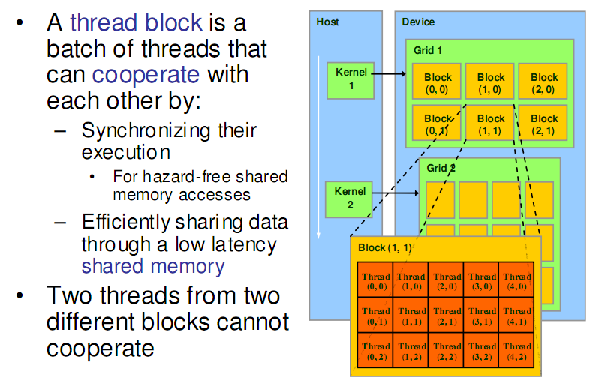
Thread Hierarchies
Image from: http://courses.engr.illinois.edu/ece498/al/textbook/Chapter2-CudaProgrammingModel.pdf

Slide 28
Thread Hierarchies - Block
1D, 2D, or 3D
Example: Index into vector, matrix, volume

Slide 29
Thread Hierarchies – Thread Id
Thread ID: Scalar thread identifier
Thread Index: threadIdx
1D: Thread ID == Thread Index
2D with size (Dx, Dy)
Thread ID of index (x, y) == x + y Dx
3D with size (Dx, Dy, Dz)
Thread ID of index (x, y, z) == x + y Dx + z Dx Dy

Slide 30
Thread Hierarchies
// Kernel Definition
__global__ void matrixAddition(const float* A, const float* B, float* C)
{
int idx = threadIdx.y * blockDim.x + threadIdx.x;
C[idx] = A[idx] + B[idx];
}
int main()
{
// ....
// Kernel invocation with one block of N * N * 1 threads
int blocks = 1;
dim3 threadsPerBlock(N, N);
vectorAdd<<<blocks, threadsPerBlock>>>(A, B, C);
}
2D Thread Index to 1D memory index
1 block
2D block of threads
Notes:
Using 2D so does not need to explicitly compute 1D thread ID from x and y

Slide 31
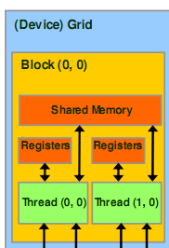
Thread Hierarchies – Thread Block
Group of threads - Up to 1024 threads
Reside on the same SM
Share memory of that SM
Image from: http://courses.engr.illinois.edu/ece498/al/textbook/Chapter2-CudaProgrammingModel.pdf

Slide 32
Thread Hierarchies
Block Index: blockIdx
Dimension: blockDim
1D or 2D

Slide 33
Thread Hierarchies
// Kernel Definition
__global__ void matrixAddition(const float* A, const float* B, float* C,
int N)
{
int x = blockIdx.x * blockDim.x + threadIdx.x;
int y = blockIdx.y * blockDim.y + threadIdx.y;
int idx = y * N + x;
C[idx] = A[idx] + B[idx];
}
int main()
{
// ....
// Kernel invocation with computed configuration
dim3 threadsPerBlock(16, 16);
dim3 blocks(N / threadPerBlock.x, N / threadPerBlock.y);
vectorAdd<<<blocks, threadsPerBlock>>>(A, B, C);
}
2D Thread Index to 1D memory index
16x16 Threads per Block
2D grid of blocks
2D block of threads
Notes:
dim3 default argument is 1

Slide 34
Thread Hierarchies
Example: N = 32 (Matrix = N rows x N columns)
16x16 threads per block (independent of N)
threadIdx ([0, 15], [0, 15])
2x2 thread blocks in grid
blockIdx ([0, 1], [0, 1])
blockDim = 16
int i = blockIdx.x * blockDim.x + threadIdx.x;
int j = blockIdx.y * blockDim.y + threadIdx.y;

Slide 35
Thread Hierarchies
Example: N=32 (Matrix = N rows x N columns)
16x16 threads per block (independent of N)
threadIdx ([0, 15], [0, 15])
2x2 thread blocks in grid
blockIdx ([0, 1], [0, 1])
blockDim = 16
int i = blockIdx.x * blockDim.x + threadIdx.x;
int j = blockIdx.y * blockDim.y + threadIdx.y;
i = [0, 1] * 16 + [0, 15]
Min => i = 0 * 16 + 0 = 0
Max => i = 1 * 16 + 15 = 31
j = [0, 1] * 16 + [0, 15]
Min => j = 0 * 16 + 0 = 0
Max => j = 1 * 16 + 15 = 31

Slide 36
Thread Hierarchies
Blocks execute independently
In any order: parallel or series
Scheduled in any order by any number of cores
Allows code to scale with core count

Slide 37
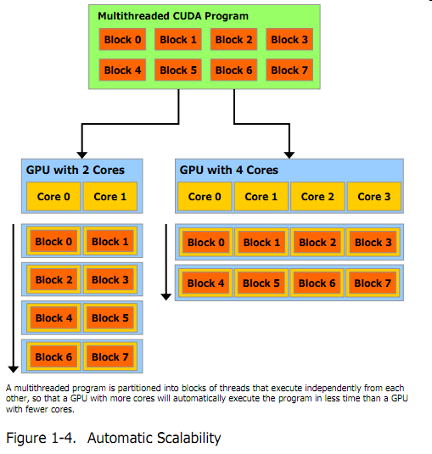
Thread Hierarchies
Image from: http://developer.download.nvidia.com/compute/cuda/3_2_prod/toolkit/docs/CUDA_C_Programming_Guide.pdf
Notes:
Scheduled by the CUDA runtime

Slide 38
Memory Management

Slide 39
Memory Management
Host and device memory are separate entities
Device pointers point to GPU memory
May be passed to/from host code
May not be dereferenced in host code
Host pointers point to CPU memory
May be passed to/from device code
May not be dereferenced in device code
Simple CUDA API for handling device memory
cudaMalloc(), cudaFree(), cudaMemcpy()
Similar to the C equivalents malloc(), free(), memcpy()

Slide 40
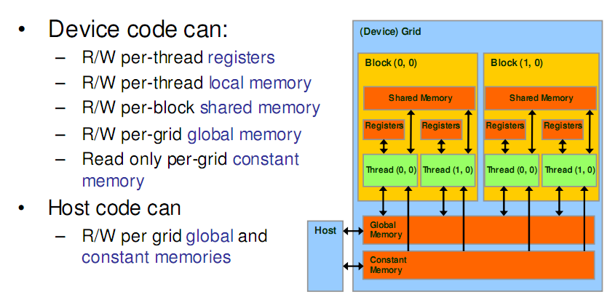
CUDA Memory Transfers
Image from: http://courses.engr.illinois.edu/ece498/al/textbook/Chapter2-CudaProgrammingModel.pdf

Slide 41
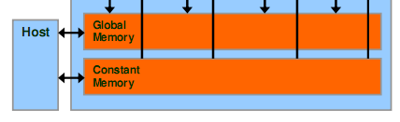
CUDA Memory Transfers
Host can transfer to/from device
Global memory
Constant memory
Image from: http://courses.engr.illinois.edu/ece498/al/textbook/Chapter2-CudaProgrammingModel.pdf

Slide 42
CUDA Memory Transfers
cudaMalloc()
Allocate global memory on device
cudaFree()
Frees memory
Image from: http://courses.engr.illinois.edu/ece498/al/textbook/Chapter2-CudaProgrammingModel.pdf

Slide 43
CUDA Memory Transfers
float *deviceMemory = NULL;
int size = width * height * sizeof(float);
cudaMalloc((void**)&deviceMemory, size); // Allocate memory
// Do work
cudaFree(deviceMemory); // Free memory

Slide 44
CUDA Memory Transfers
float *deviceMemory = NULL;
int size = width * height * sizeof(float);
cudaMalloc((void**)&deviceMemory, size); // Allocate memory
// Do work
cudaFree(deviceMemory); // Free memory
Size in bytes
Pointer to device memory

Slide 45
CUDA Memory Transfers
cudaMemcpy()
Host to host
Host to device
Device to host
Device to device
Host
Device
Global Memory

Slide 46
CUDA Memory Transfers
cudaMemcpy()
Host to host
Host to device
Device to host
Device to device
Host
Device
Global Memory

Slide 47
CUDA Memory Transfers
cudaMemcpy()
Host to host
Host to device
Device to host
Device to device
Host
Device
Global Memory
cudaMemcpy(devicePtr, hostPtr, size, cudaMemcpyHostToDevice);
Destination (device)
Source (host)
Copy direction

Slide 48
CUDA Memory Transfers
cudaMemcpy()
Host to host
Host to device
Device to host
Device to device
Host
Device
Global Memory
cudaMemcpy(hostPtr, devicePtr, size cudaMemcpyDeviceToHost);
Destination (host)
Source (device)
Copy direction

Slide 49
CUDA Memory Transfers
cudaMemcpy()
Host to host
Host to device
Device to host
Device to device
Host
Device
Global Memory
cudaMemcpy(destPtr, srcPtr, size cudaMemcpyDeviceToDevice);
Destination (device)
Source (device)
Copy direction

Slide 50
Vector Addition

Slide 51
Vector Addition – Full CUDA Program
int main( int argc, char* argv[] ) {
// Size of vectors
int n = 100000;
// Host vectors
float *h_a, *h_b, *h_c;
// Device vectors
float *d_a, *d_b, *d_c;
// Size, in bytes, of each vector
size_t bytes = n*sizeof(float);
// Allocate memory for each vector on host
h_a = (float*)malloc(bytes);
h_b = (float*)malloc(bytes);
h_c = (float*)malloc(bytes);
// Allocate memory for each vector on GPU
cudaMalloc(&d_a, bytes);
cudaMalloc(&d_b, bytes);
cudaMalloc(&d_c, bytes);
// Initialize vectors on host
for(int i = 0; i < n; i++ ) {
h_a[i] = sin(i)*sin(i);
h_b[i] = cos(i)*cos(i);
}
// Copy host vectors to device
cudaMemcpy(d_a, h_a, bytes, cudaMemcpyHostToDevice);
cudaMemcpy(d_b, h_b, bytes, cudaMemcpyHostToDevice);
// Number of threads in each thread block
int blockSize = 1024;
// Number of thread blocks in grid
int gridSize = (int)ceil((float)n/blockSize);
// Execute the kernel
vecAdd<<<gridSize, blockSize>>>(d_a, d_b, d_c, n);
// Copy array back to host
cudaMemcpy(h_c, d_c, bytes, cudaMemcpyDeviceToHost);
// Release device memory
cudaFree(d_a); cudaFree(d_b); cudaFree(d_c);
// Release host memory
free(h_a); free(h_b); free(h_c);
return 0;
}

Slide 52
Vector Addition – Full CUDA Program
// CUDA kernel. Each thread takes care of one element of c
__global__ void vecAdd(float *a, float *b, float *c, int n)
{
// Get our global thread ID
int id = blockIdx.x * blockDim.x + threadIdx.x;
// Make sure we do not go out of bounds
if (id < n)
c[id] = a[id] + b[id];
}

Slide 53
Matrix Multiply

Slide 54
Matrix Multiply Reminder
Vectors
Dot products
Row major or column major?
Dot product per output element

Slide 55
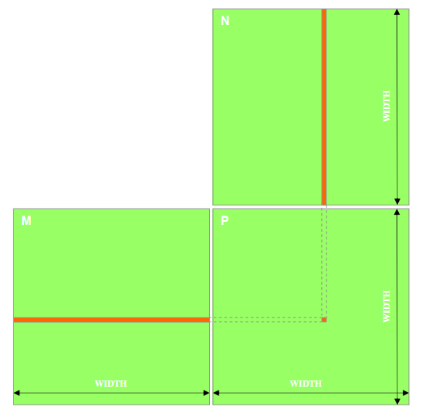
Matrix Multiply
P = M * N
Assume M and N are square for simplicity
Image from: http://courses.engr.illinois.edu/ece498/al/textbook/Chapter2-CudaProgrammingModel.pdf

Slide 56
Matrix Multiply
1,000 x 1,000 matrix
Anyone want to take a guess on the number of operations involved?
Notes:
Or 999 adds depending on the code.

Slide 57
Matrix Multiply: CPU Implementation
void MatrixMultiplyOnHost(float* M, float* N, float* P, int width)‏
{
for (int i = 0; i < width; ++i)‏
{
for (int j = 0; j < width; ++j)
{
float sum = 0;
for (int k = 0; k < width; ++k)
{
float a = M[i * width + k];
float b = N[k * width + j];
sum += a * b;
}
P[i * width + j] = sum;
}
}
}
Code from: http://courses.engr.illinois.edu/ece498/al/lectures/lecture3%20cuda%20threads%20spring%202010.ppt
Notes:
Row major. The inner most loop goes across a row of M, and down a column of N.

Slide 58
Matrix Multiply
1,000 x 1,000 matrix
1,000,000 dot products
Each 1,000 multiples and 1,000 adds
1 Billion multiplies and 1 Billion adds!!!
Notes:
Or 999 adds depending on the code.

Slide 59
Matrix Multiply: CUDA Skeleton
int main() {
// 1. Allocate and Initialize M, N, and result P matrices
// Copy M, N matrices to device
// 2. M * N on device
// 3. Copy P matrix to host and output
// Free device memory and clean up
return 0;
}

Slide 60
Matrix Multiply
Step 1:
Add CUDA memory transfers to the skeleton

Slide 61
Matrix Multiply: Data Transfer
void MatrixMultiplyOnDevice(float* hostP, const float* hostM, const float* hostN, const int width)
{
int sizeInBytes = width * width * sizeof(float);
float *devM, *devN, *devP;
// Allocate M and N on device
cudaMalloc((void**)&devM, sizeInBytes);
cudaMalloc((void**)&devN, sizeInBytes);
// Allocate P
cudaMalloc((void**)&devP, sizeInBytes);
// Copy M and N from host to device
cudaMemcpy(devM, hostM, sizeInBytes, cudaMemcpyHostToDevice);
cudaMemcpy(devN, hostN, sizeInBytes, cudaMemcpyHostToDevice);
// Call the kernel here - Later
// Copy P matrix from device to host
cudaMemcpy(hostP, devP, sizeInBytes, cudaMemcpyDeviceToHost);
// Free allocated memory
cudaFree(devM); cudaFree(devN); cudaFree(devP);
}
Notes:
Error in cudaMalloc calls: should pass address of point, e.g., “(void *)&Md”

Slide 62
Matrix Multiply: Data Transfer
void MatrixMultiplyOnDevice(float* hostP, const float* hostM, const float* hostN, const int width)
{
int sizeInBytes = width * width * sizeof(float);
float *devM, *devN, *devP;
// Allocate M and N on device
cudaMalloc((void**)&devM, sizeInBytes);
cudaMalloc((void**)&devN, sizeInBytes);
// Allocate P
cudaMalloc((void**)&devP, sizeInBytes);
// Copy M and N from host to device
cudaMemcpy(devM, hostM, sizeInBytes, cudaMemcpyHostToDevice);
cudaMemcpy(devN, hostN, sizeInBytes, cudaMemcpyHostToDevice);
// Call the kernel here - Later
// Copy P matrix from device to host
cudaMemcpy(hostP, devP, sizeInBytes, cudaMemcpyDeviceToHost);
// Free allocated memory
cudaFree(devM); cudaFree(devN); cudaFree(devP);
}
Notes:
Error in cudaMalloc calls: should pass address of point, e.g., “(void *)&Md”

Slide 63
Matrix Multiply: Data Transfer
void MatrixMultiplyOnDevice(float* hostP, const float* hostM, const float* hostN, const int width)
{
int sizeInBytes = width * width * sizeof(float);
float *devM, *devN, *devP;
// Allocate M and N on device
cudaMalloc((void**)&devM, sizeInBytes);
cudaMalloc((void**)&devN, sizeInBytes);
// Allocate P
cudaMalloc((void**)&devP, sizeInBytes);
// Copy M and N from host to device
cudaMemcpy(devM, hostM, sizeInBytes, cudaMemcpyHostToDevice);
cudaMemcpy(devN, hostN, sizeInBytes, cudaMemcpyHostToDevice);
// Call the kernel here - Later
// Copy P matrix from device to host
cudaMemcpy(hostP, devP, sizeInBytes, cudaMemcpyDeviceToHost);
// Free allocated memory
cudaFree(devM); cudaFree(devN); cudaFree(devP);
}

Slide 64
Matrix Multiply: Data Transfer
void MatrixMultiplyOnDevice(float* hostP, const float* hostM, const float* hostN, const int width)
{
int sizeInBytes = width * width * sizeof(float);
float *devM, *devN, *devP;
// Allocate M and N on device
cudaMalloc((void**)&devM, sizeInBytes);
cudaMalloc((void**)&devN, sizeInBytes);
// Allocate P
cudaMalloc((void**)&devP, sizeInBytes);
// Copy M and N from host to device
cudaMemcpy(devM, hostM, sizeInBytes, cudaMemcpyHostToDevice);
cudaMemcpy(devN, hostN, sizeInBytes, cudaMemcpyHostToDevice);
// Call the kernel here - Later
// Copy P matrix from device to host
cudaMemcpy(hostP, devP, sizeInBytes, cudaMemcpyDeviceToHost);
// Free allocated memory
cudaFree(devM); cudaFree(devN); cudaFree(devP);
}
Notes:
Error in cudaMalloc calls: should pass address of point, e.g., “(void *)&Md”

Slide 65
Matrix Multiply: Data Transfer
void MatrixMultiplyOnDevice(float* hostP, const float* hostM, const float* hostN, const int width)
{
int sizeInBytes = width * width * sizeof(float);
float *devM, *devN, *devP;
// Allocate M and N on device
cudaMalloc((void**)&devM, sizeInBytes);
cudaMalloc((void**)&devN, sizeInBytes);
// Allocate P
cudaMalloc((void**)&devP, sizeInBytes);
// Copy M and N from host to device
cudaMemcpy(devM, hostM, sizeInBytes, cudaMemcpyHostToDevice);
cudaMemcpy(devN, hostN, sizeInBytes, cudaMemcpyHostToDevice);
// Call the kernel here - Later
// Copy P matrix from device to host
cudaMemcpy(hostP, devP, sizeInBytes, cudaMemcpyDeviceToHost);
// Free allocated memory
cudaFree(devM); cudaFree(devN); cudaFree(devP);
}
Notes:
Error in cudaMalloc calls: should pass address of point, e.g., “(void *)&Md”

Slide 66
Matrix Multiply: Data Transfer
void MatrixMultiplyOnDevice(float* hostP, const float* hostM, const float* hostN, const int width)
{
int sizeInBytes = width * width * sizeof(float);
float *devM, *devN, *devP;
// Allocate M and N on device
cudaMalloc((void**)&devM, sizeInBytes);
cudaMalloc((void**)&devN, sizeInBytes);
// Allocate P
cudaMalloc((void**)&devP, sizeInBytes);
// Copy M and N from host to device
cudaMemcpy(devM, hostM, sizeInBytes, cudaMemcpyHostToDevice);
cudaMemcpy(devN, hostN, sizeInBytes, cudaMemcpyHostToDevice);
// Call the kernel here - Later
// Copy P matrix from device to host
cudaMemcpy(hostP, devP, sizeInBytes, cudaMemcpyDeviceToHost);
// Free allocated memory
cudaFree(devM); cudaFree(devN); cudaFree(devP);
}
Notes:
Error in cudaMalloc calls: should pass address of point, e.g., “(void *)&Md”

Slide 67
Matrix Multiply
Step 1:
Add CUDA memory transfers to the skeleton
Step 2:
Implement the kernel in CUDA C

Slide 68
Matrix Multiply: CUDA Kernel
__global__ void MatrixMultiplyKernel(const float* devM, const float* devN,
float* devP, const int width)
{
int tx = threadIdx.x;
int ty = threadIdx.y;
// Initialize accumulator to 0
float pValue = 0;
// Multiply and add
for (int k = 0; k < width; k++) {
float m = devM[ty * width + k];
float n = devN[k * width + tx];
pValue += m * n;
}
// Write value to device memory - each thread has unique index to write to
devP[ty * width + tx] = pValue;
}

Slide 69
Matrix Multiply: CUDA Kernel
__global__ void MatrixMultiplyKernel(const float* devM, const float* devN,
float* devP, const int width)
{
int tx = threadIdx.x;
int ty = threadIdx.y;
// Initialize accumulator to 0
float pValue = 0;
// Multiply and add
for (int k = 0; k < width; k++) {
float m = devM[ty * width + k];
float n = devN[k * width + tx];
pValue += m * n;
}
// Write value to device memory - each thread has unique index to write to
devP[ty * width + tx] = pValue;
}
Kernel specifier
Specify const buffers
for read-only
Always void
No const for buffers that will be written to

Slide 70
Matrix Multiply: CUDA Kernel
__global__ void MatrixMultiplyKernel(const float* devM, const float* devN,
float* devP, const int width)
{
int tx = threadIdx.x;
int ty = threadIdx.y;
// Initialize accumulator to 0
float pValue = 0;
// Multiply and add
for (int k = 0; k < width; k++) {
float m = devM[ty * width + k];
float n = devN[k * width + tx];
pValue += m * n;
}
// Write value to device memory - each thread has unique index to write to
devP[ty * width + tx] = pValue;
}
Accessing a Matrix, use 2D threads

Slide 71
Matrix Multiply: CUDA Kernel
__global__ void MatrixMultiplyKernel(const float* devM, const float* devN,
float* devP, const int width)
{
int tx = threadIdx.x;
int ty = threadIdx.y;
// Initialize accumulator to 0
float pValue = 0;
// Multiply and add
for (int k = 0; k < width; k++) {
float m = devM[ty * width + k];
float n = devN[k * width + tx];
pValue += m * n;
}
// Write value to device memory - each thread has unique index to write to
devP[ty * width + tx] = pValue;
}
Each kernel thread computes one location of the matrix

Slide 72
Matrix Multiply: CUDA Kernel
__global__ void MatrixMultiplyKernel(const float* devM, const float* devN,
float* devP, const int width)
{
int tx = threadIdx.x;
int ty = threadIdx.y;
// Initialize accumulator to 0
float pValue = 0;
// Multiply and add
for (int k = 0; k < width; k++) {
float m = devM[ty * width + k];
float n = devN[k * width + tx];
pValue += m * n;
}
// Write value to device memory - each thread has unique index to write to
devP[ty * width + tx] = pValue;
}
What happened to the 2 outer loops?

Slide 73
Matrix Multiply: CUDA Kernel
__global__ void MatrixMultiplyKernel(const float* devM, const float* devN,
float* devP, const int width)
{
int tx = threadIdx.x;
int ty = threadIdx.y;
// Initialize accumulator to 0
float pValue = 0;
// Multiply and add
for (int k = 0; k < width; k++) {
float m = devM[ty * width + k];
float n = devN[k * width + tx];
pValue += m * n;
}
// Write value to device memory - each thread has unique index to write to
devP[ty * width + tx] = pValue;
}
2D Matrix but 1D access

Slide 74
Matrix Multiply: CUDA Kernel
__global__ void MatrixMultiplyKernel(const float* devM, const float* devN,
float* devP, const int width)
{
int tx = threadIdx.x;
int ty = threadIdx.y;
// Initialize accumulator to 0
float pValue = 0;
// Multiply and add
for (int k = 0; k < width; k++) {
float m = devM[ty * width + k];
float n = devN[k * width + tx];
pValue += m * n;
}
// Write value to device memory - each thread has unique index to write to
devP[ty * width + tx] = pValue;
}
Are we missing synchronization? Why?

Slide 75
Matrix Multiply: CUDA Kernel
__global__ void MatrixMultiplyKernel(const float* devM, const float* devN,
float* devP, const int width)
{
int tx = threadIdx.x;
int ty = threadIdx.y;
// Initialize accumulator to 0
float pValue = 0;
// Multiply and add
for (int k = 0; k < width; k++) {
float m = devM[ty * width + k];
float n = devN[k * width + tx];
pValue += m * n;
}
// Write value to device memory - each thread has unique index to write to
devP[ty * width + tx] = pValue;
}
Write the value to the correct output index.

Slide 76
Matrix Multiply
Step 1:
Add CUDA memory transfers to the skeleton
Step 2:
Implement the kernel in CUDA C
Step 3:
Invoke the kernel

Slide 77
Matrix Multiply: Invoke Kernel
void MatrixMultiplyOnDevice(float* hostP,
const float* hostM, const float* hostN, const int width)
{
………
// Allocate P on device
cudaMalloc((void**)&devP, sizeInBytes);
// Call the kernel here
// Copy P matrix from device to host
cudaMemcpy(hostP, devP, sizeInBytes, cudaMemcpyDeviceToHost);
………
}
// Setup thread/block execution configuration
dim3 threads(width, width);
dim3 blocks(1, 1);
// Launch the kernel
MatrixMultiplyKernel<<<blocks, threads>>>(devM, devN, devP, width)
Each block has (width, width) threads
Launch 1 block

Slide 78
Matrix Multiply: Invoke Kernel
void MatrixMultiplyOnDevice(float* hostP,
const float* hostM, const float* hostN, const int width)
{
………
// Allocate P on device
cudaMalloc((void**)&devP, sizeInBytes);
// Call the kernel here
// Copy P matrix from device to host
cudaMemcpy(hostP, devP, sizeInBytes, cudaMemcpyDeviceToHost);
………
}
// Setup thread/block execution configuration
dim3 threads(width, width);
dim3 blocks(1, 1);
// Launch the kernel
MatrixMultiplyKernel<<<blocks, threads>>>(devM, devN, devP, width)
Like calling a function, but with launch configuration

Slide 79
Matrix Multiply
What is the major performance problem with our implementation?
What is the major limitation?
What were our assumptions for this kernel?
Notes:
Global memory access
Matrix size is limited by block size
We assumed a square matrix

Slide 80
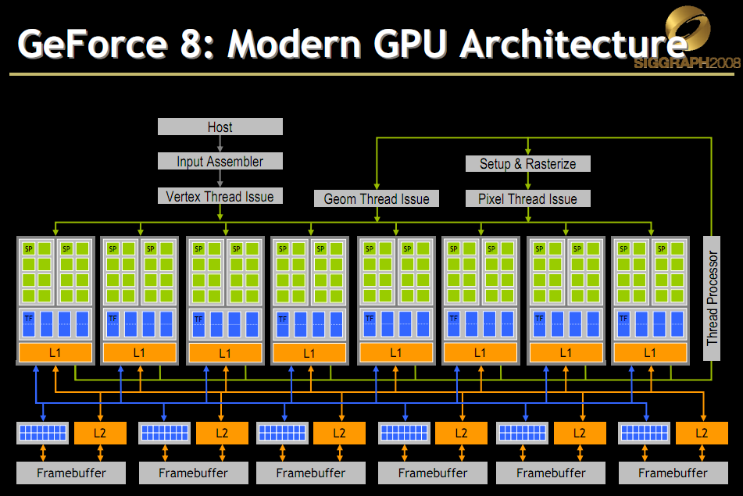
Scheduling Threads
Slide from David Luebke: http://s08.idav.ucdavis.edu/luebke-nvidia-gpu-architecture.pdf
Notes:
G80 – 16 SMs, each with 8 SP.

Slide 81
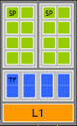
Scheduling Threads

Slide 82
Scheduling Threads
Streaming Processor (SP)

Slide 83
Scheduling Threads
Streaming Processors (SPs)

Slide 84
Scheduling Threads - G80
GT80
16 SMs
Each with 8 SPs
128 total SPs
Slide from David Luebke: http://s08.idav.ucdavis.edu/luebke-nvidia-gpu-architecture.pdf
Notes:
30 SMs * 1024 threads = 30,720 threads in flight

Slide 85
Scheduling Threads - G80
Each SM can host: 768 Threads
Example:
6 blocks of upto 128 threads
3 blocks of 256 threads
1 block of 512 threads
Slide from David Luebke: http://s08.idav.ucdavis.edu/luebke-nvidia-gpu-architecture.pdf
Notes:
30 SMs * 1024 threads = 30,720 threads in flight

Slide 86
Scheduling Threads - G80
In flight:
1 SM: 768 Threads
16 SMs: 16 * 768 = 12288
Slide from David Luebke: http://s08.idav.ucdavis.edu/luebke-nvidia-gpu-architecture.pdf
Notes:
30 SMs * 1024 threads = 30,720 threads in flight

Slide 87
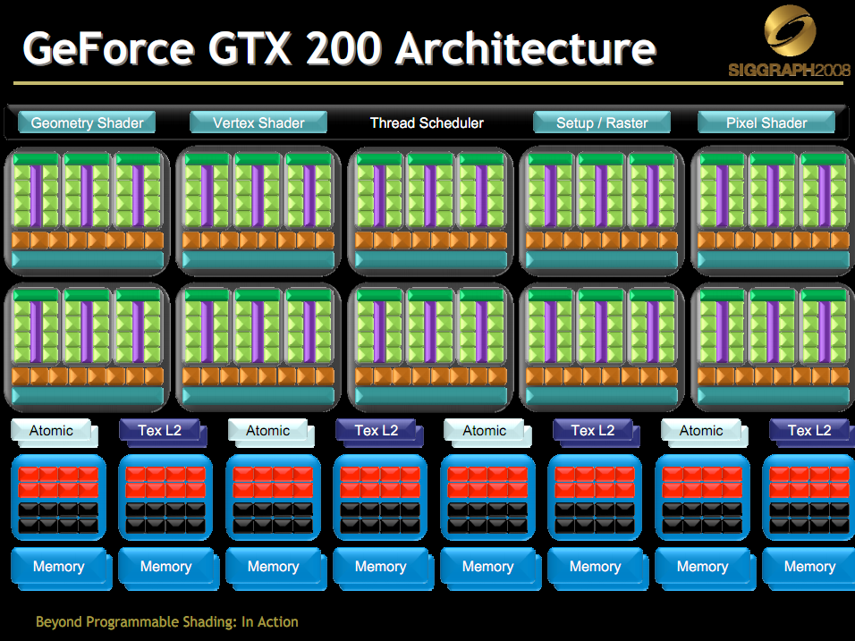
Scheduling Threads - GT200
GT200
30 SMs
Each with 8 SPs
240 total SPs
Slide from David Luebke: http://s08.idav.ucdavis.edu/luebke-nvidia-gpu-architecture.pdf
Notes:
30 SMs * 1024 threads = 30,720 threads in flight

Slide 88
Scheduling Threads - GT200
Each SM can host
8 Blocks, or
1024 Threads
Example:
8 blocks of upto 128 threads
4 blocks of 256 threads
1 block of 1024 threads
Slide from David Luebke: http://s08.idav.ucdavis.edu/luebke-nvidia-gpu-architecture.pdf
Notes:
30 SMs * 1024 threads = 30,720 threads in flight

Slide 89
Scheduling Threads - GT200
In flight:
1 SM: 1024 Threads
30 SMs: 30 * 1024 = 30720 threads
1 SM: 8 Blocks
30 SMs: 30 * 8 = 240 Blocks
Slide from David Luebke: http://s08.idav.ucdavis.edu/luebke-nvidia-gpu-architecture.pdf
Notes:
30 SMs * 1024 threads = 30,720 threads in flight

Slide 90
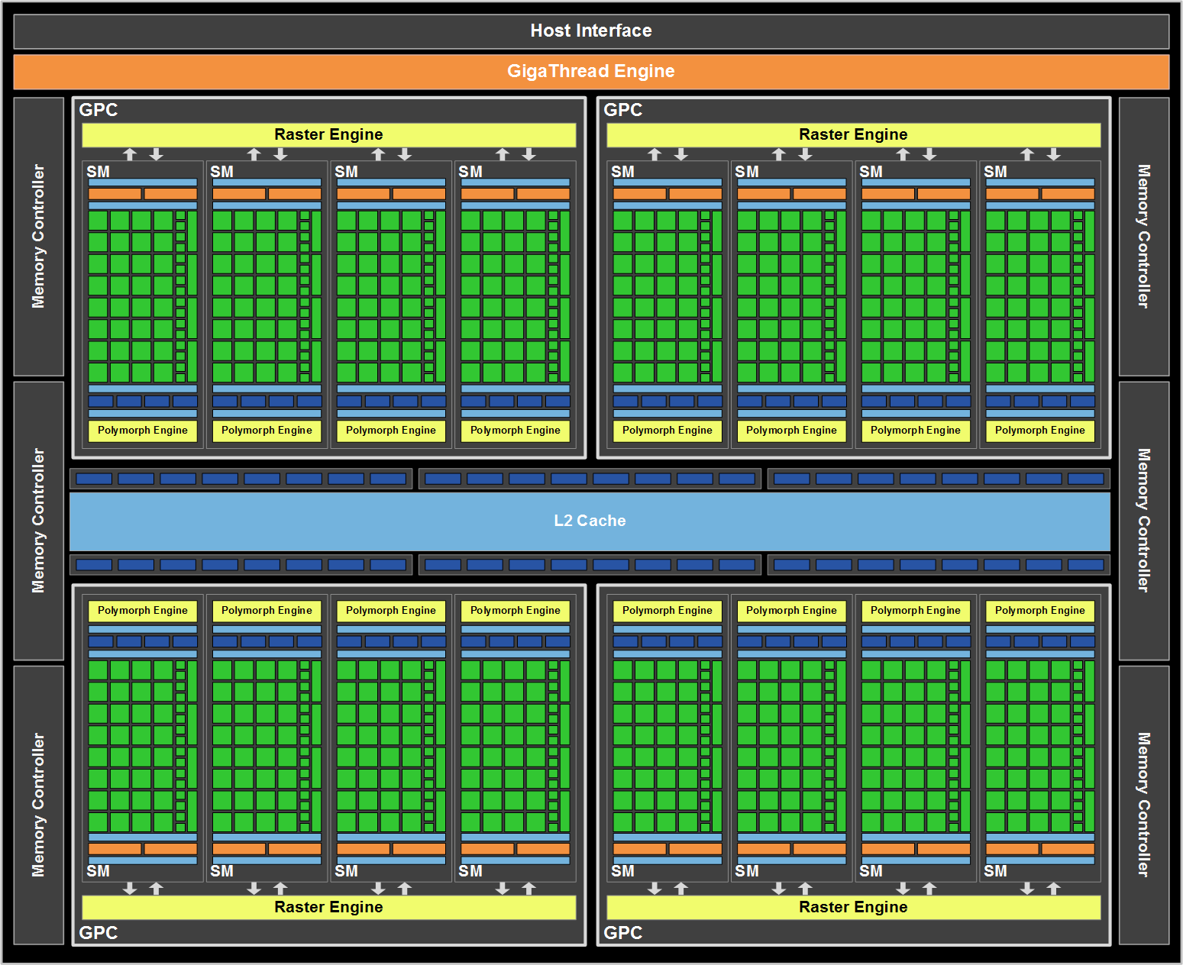
Fermi (GF110)
16 SMs
Each 32 Cores
Each SM Hosts upto
48 warps, or
1536 threads
In flight 24,576 threads

Slide 91
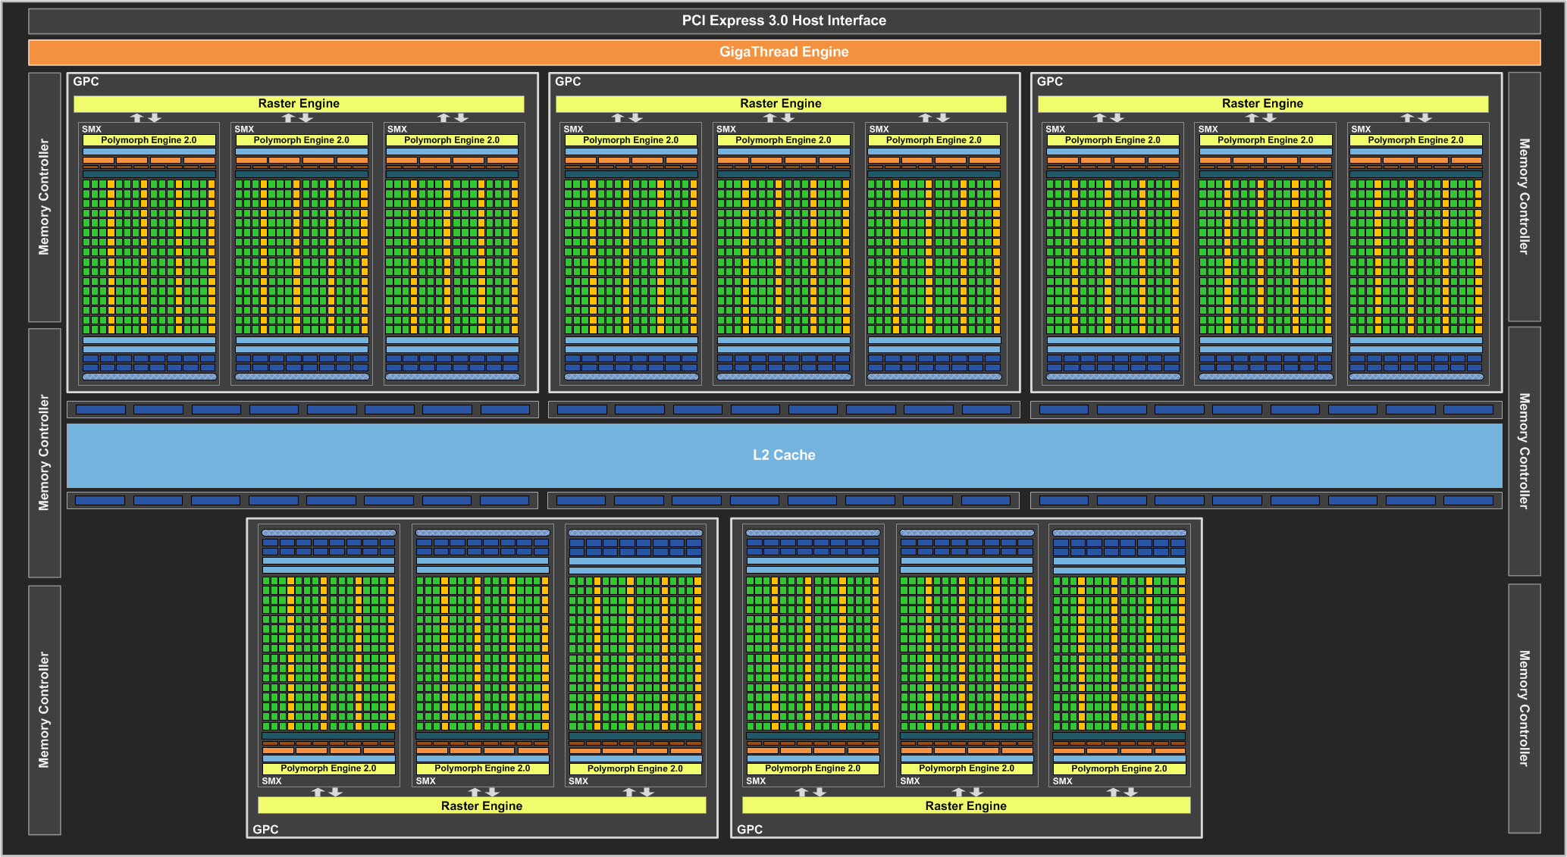
Kepler GPU Architecture (GK110 in GTX780Ti)

Slide 92
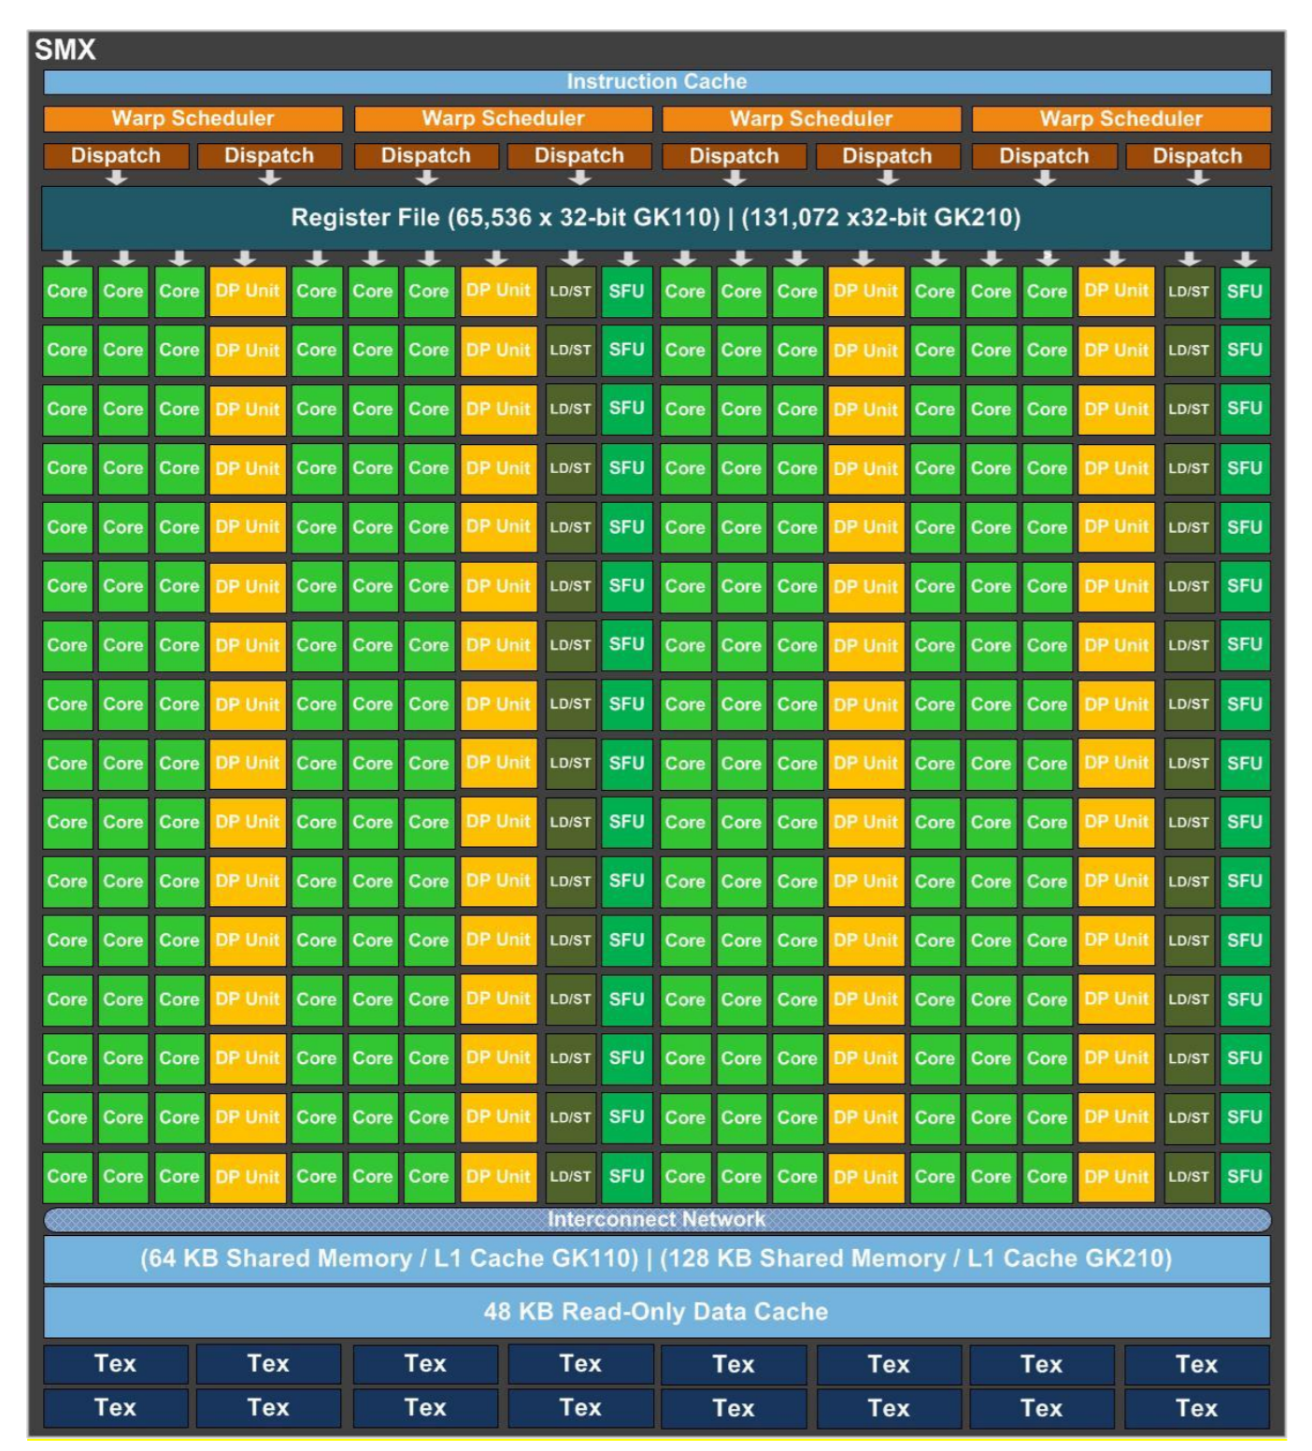
Kepler SMX
192 single-precision CUDA cores
64 double-precision units
32 special function units (SFU)
32 load/store units (LD/ST).
SM and SMX refer to the same hardware concept. In Kepler, NVIDIA called it Next-Gen SM or “SMX”

Slide 93
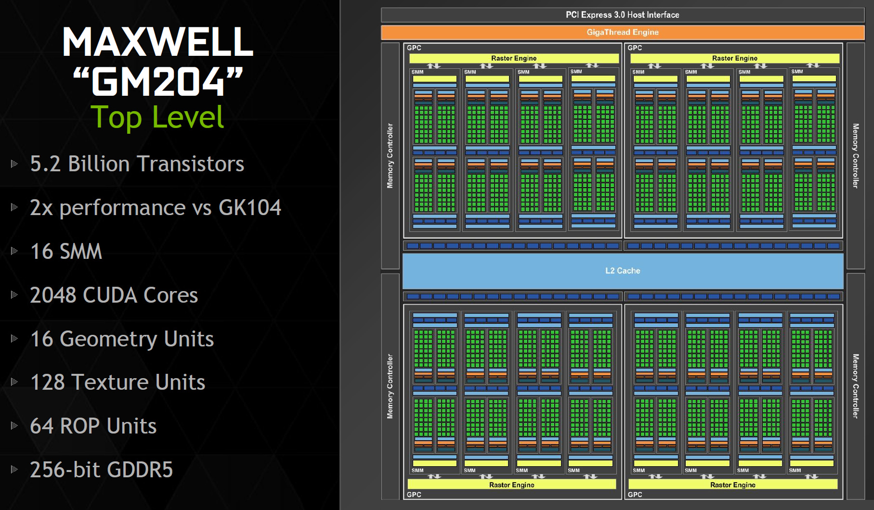

Slide 94
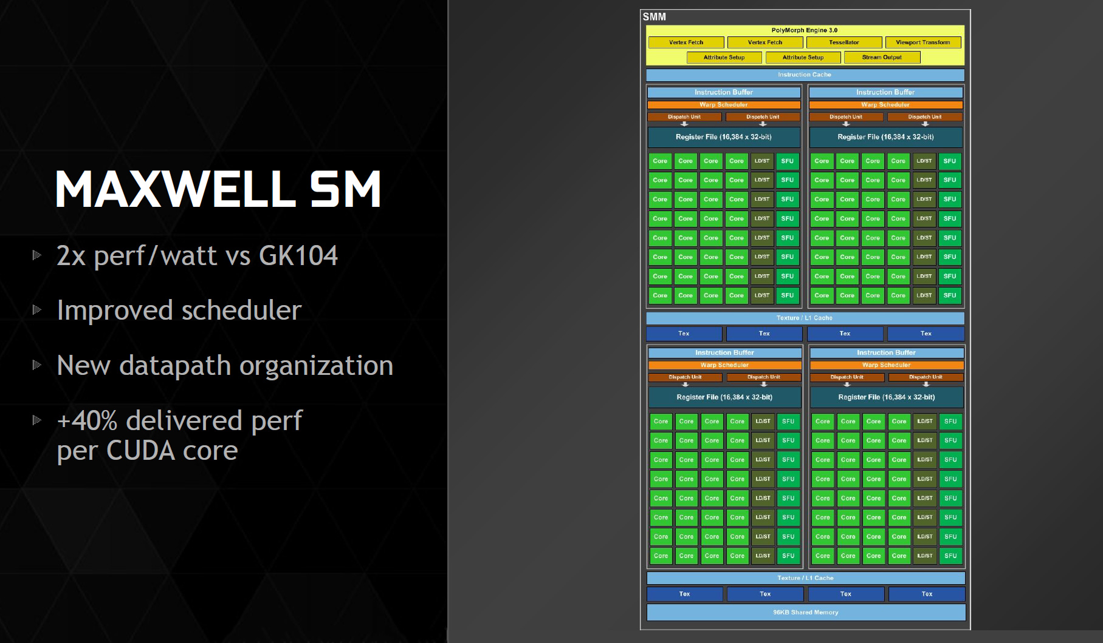

Slide 95
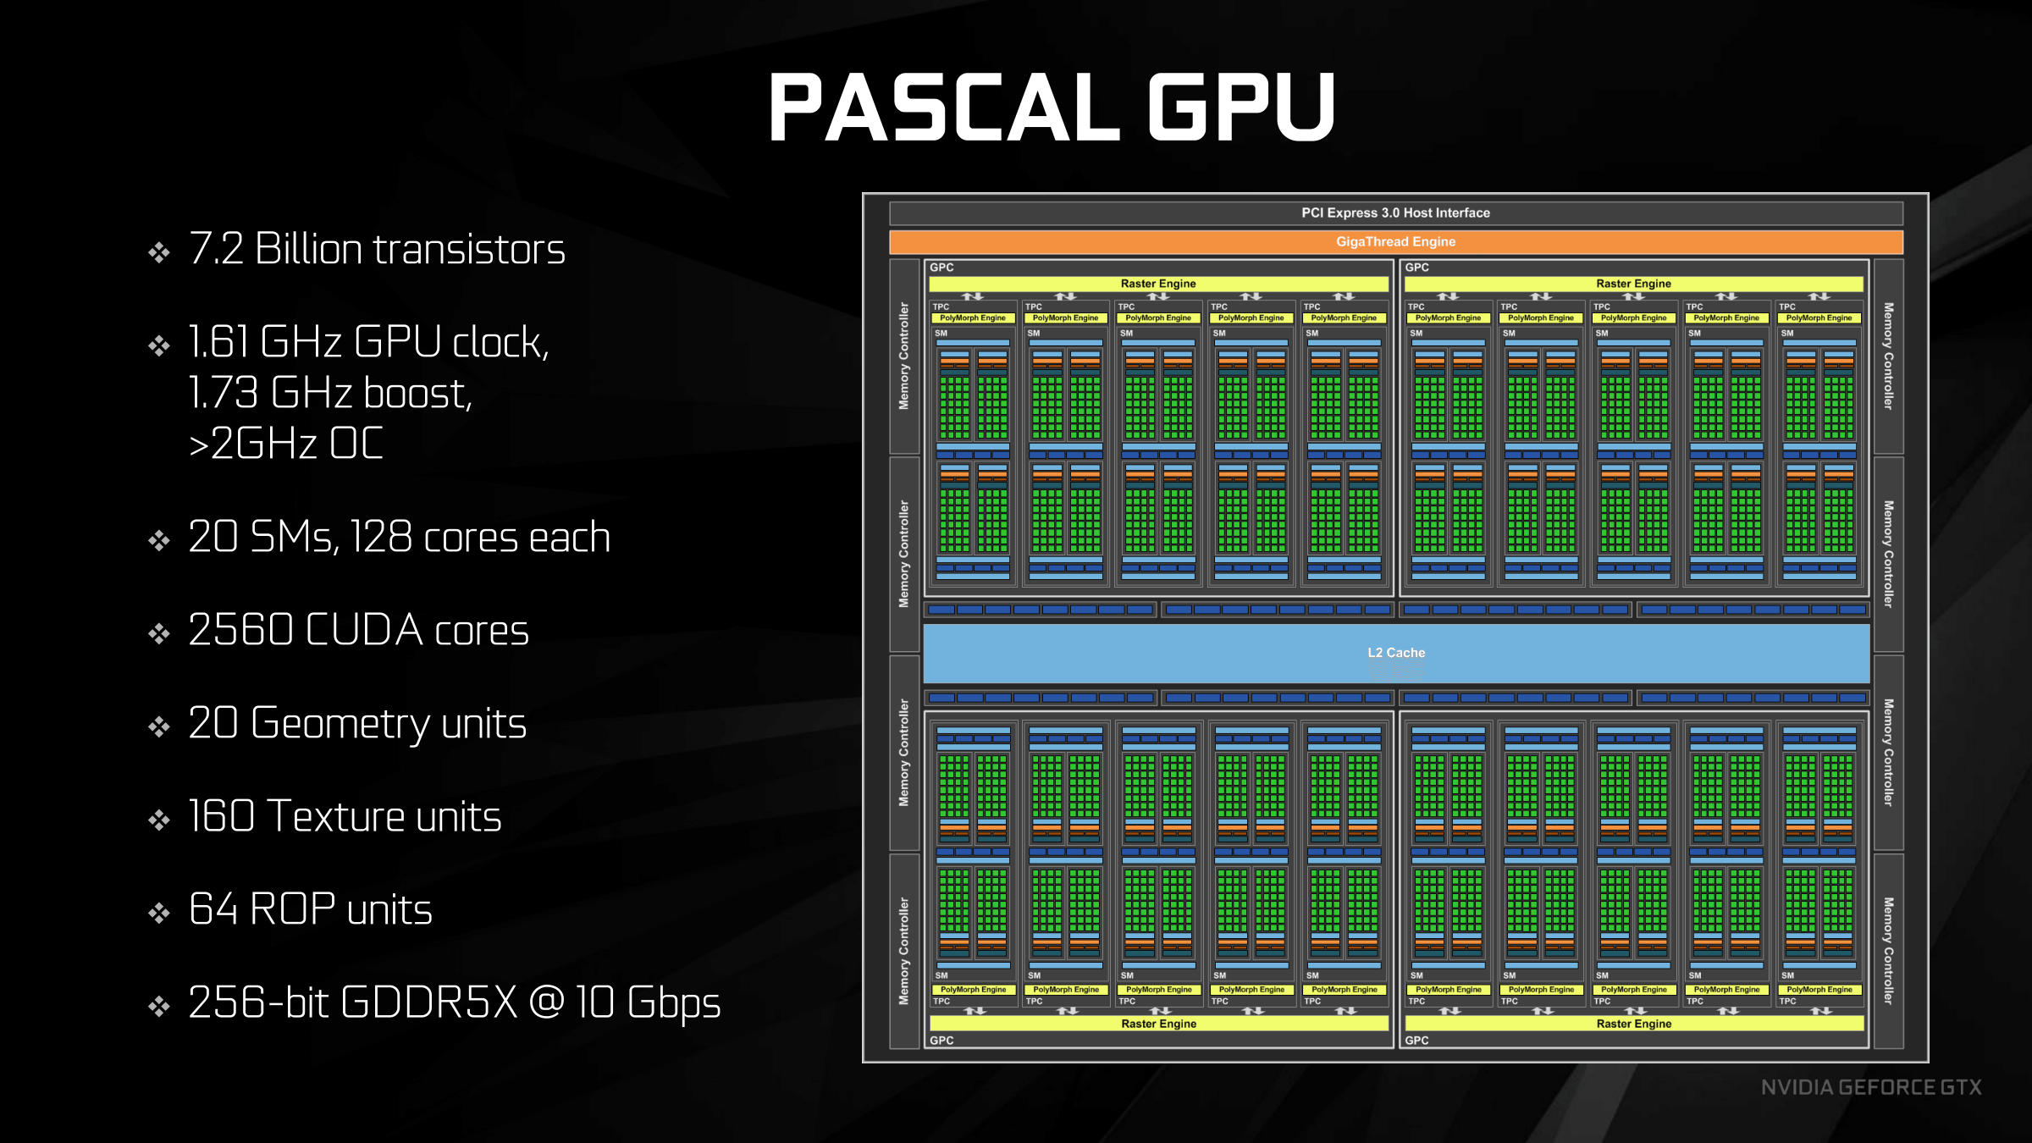

Slide 96
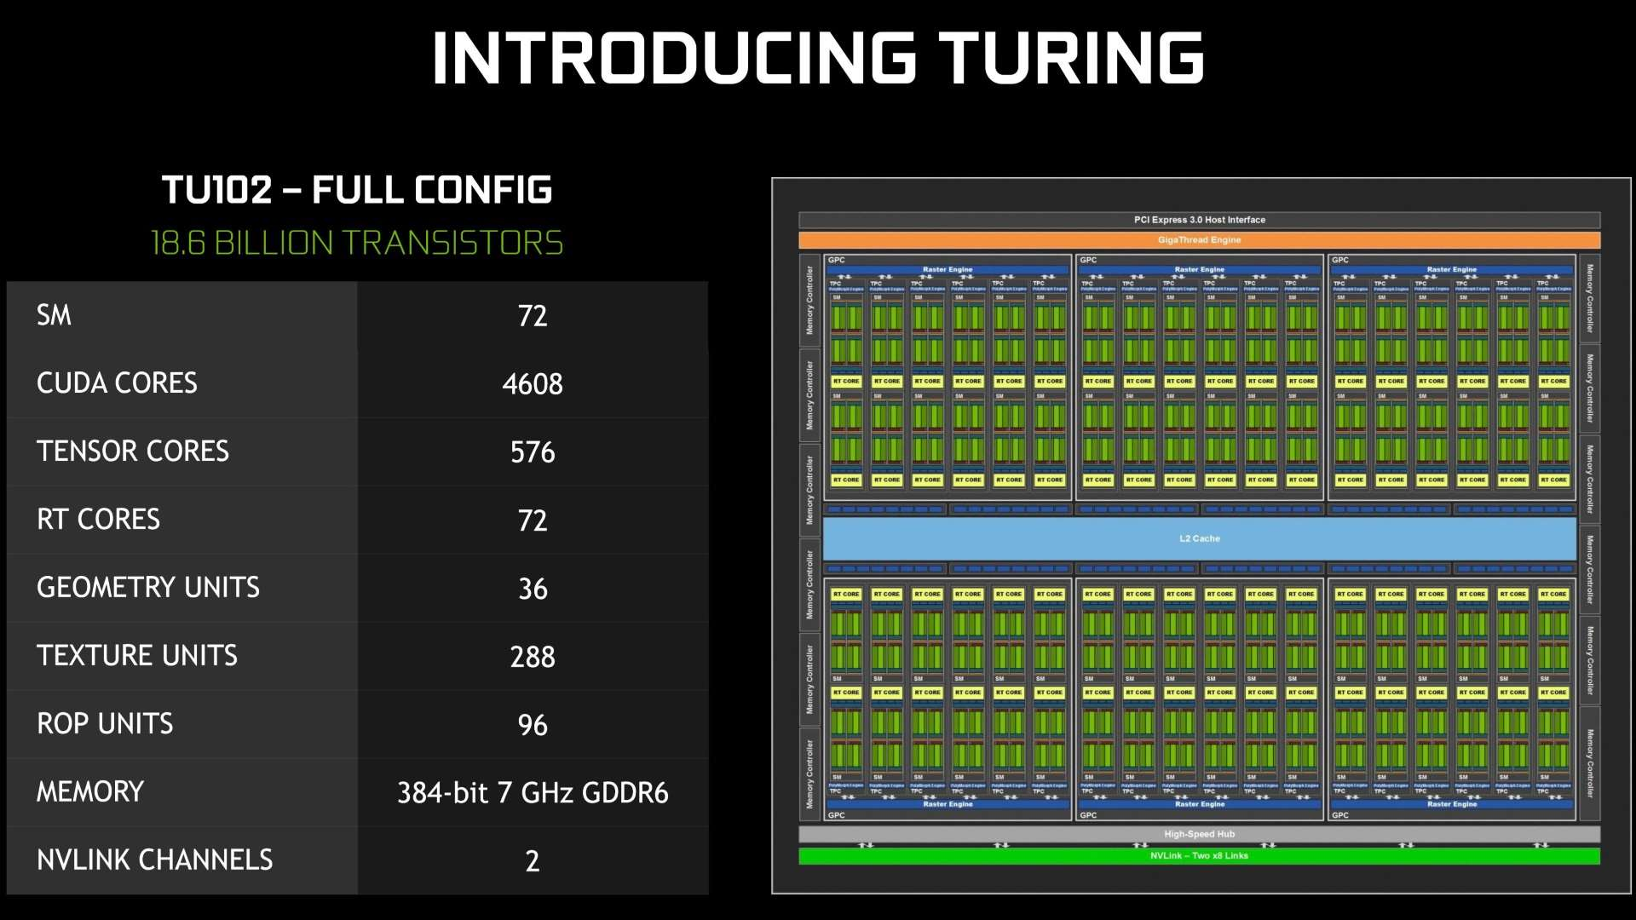
https://developer.nvidia.com/blog/nvidia-turing-architecture-in-depth/

Slide 97
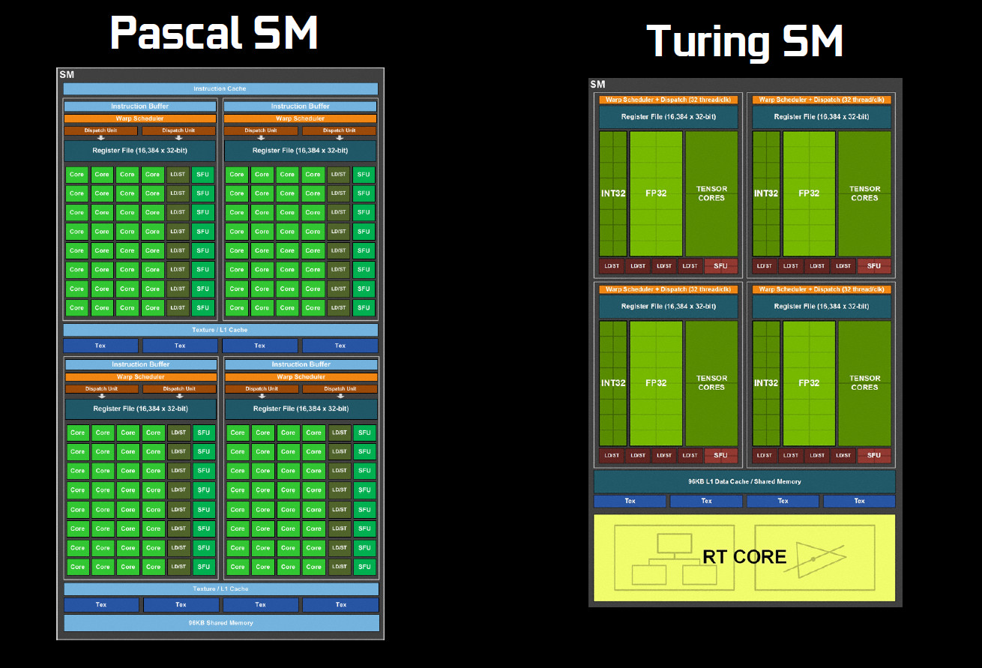

Slide 98
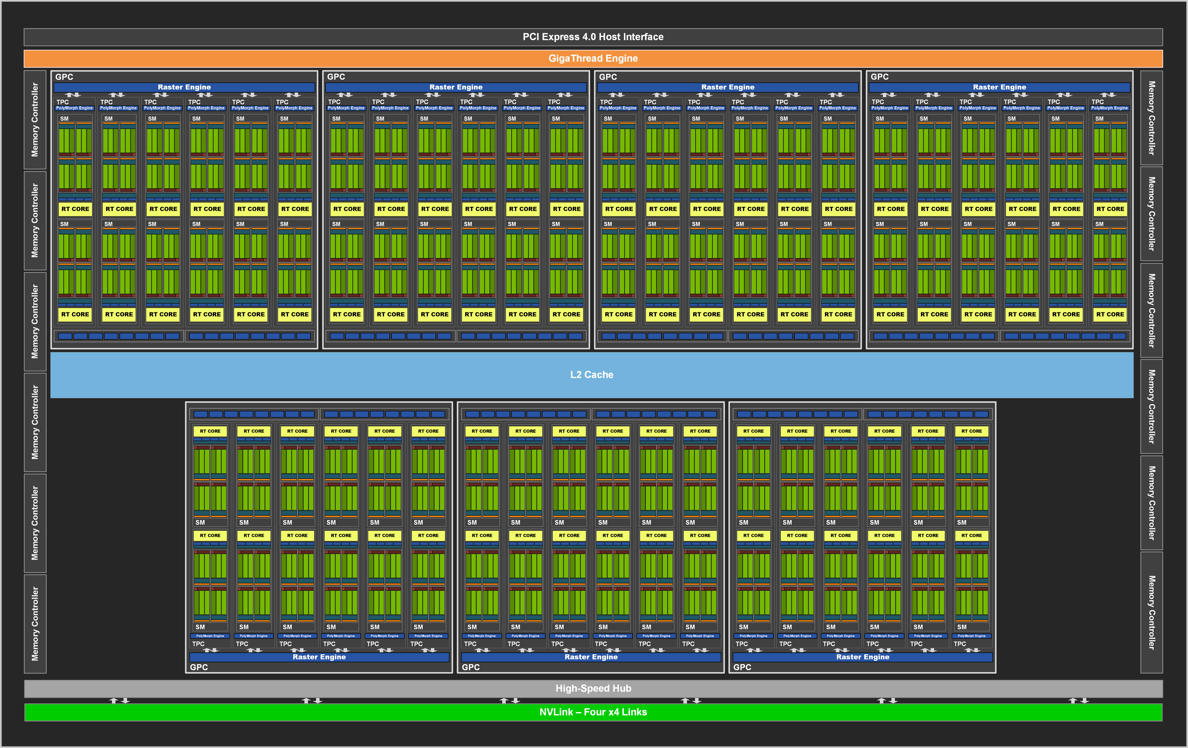
GA102 (Ampere)
7 GPCs (Graphics Processing Clusters)
42 TPCs (Texture Processing Clusters)
84 SMs
10.752 FP32 Units
84 2nd Gen RT Cores
336 3rd Gen Tensor Cores
(RTX 3090 is not using the full GA102 - two SMs not active)

Slide 99
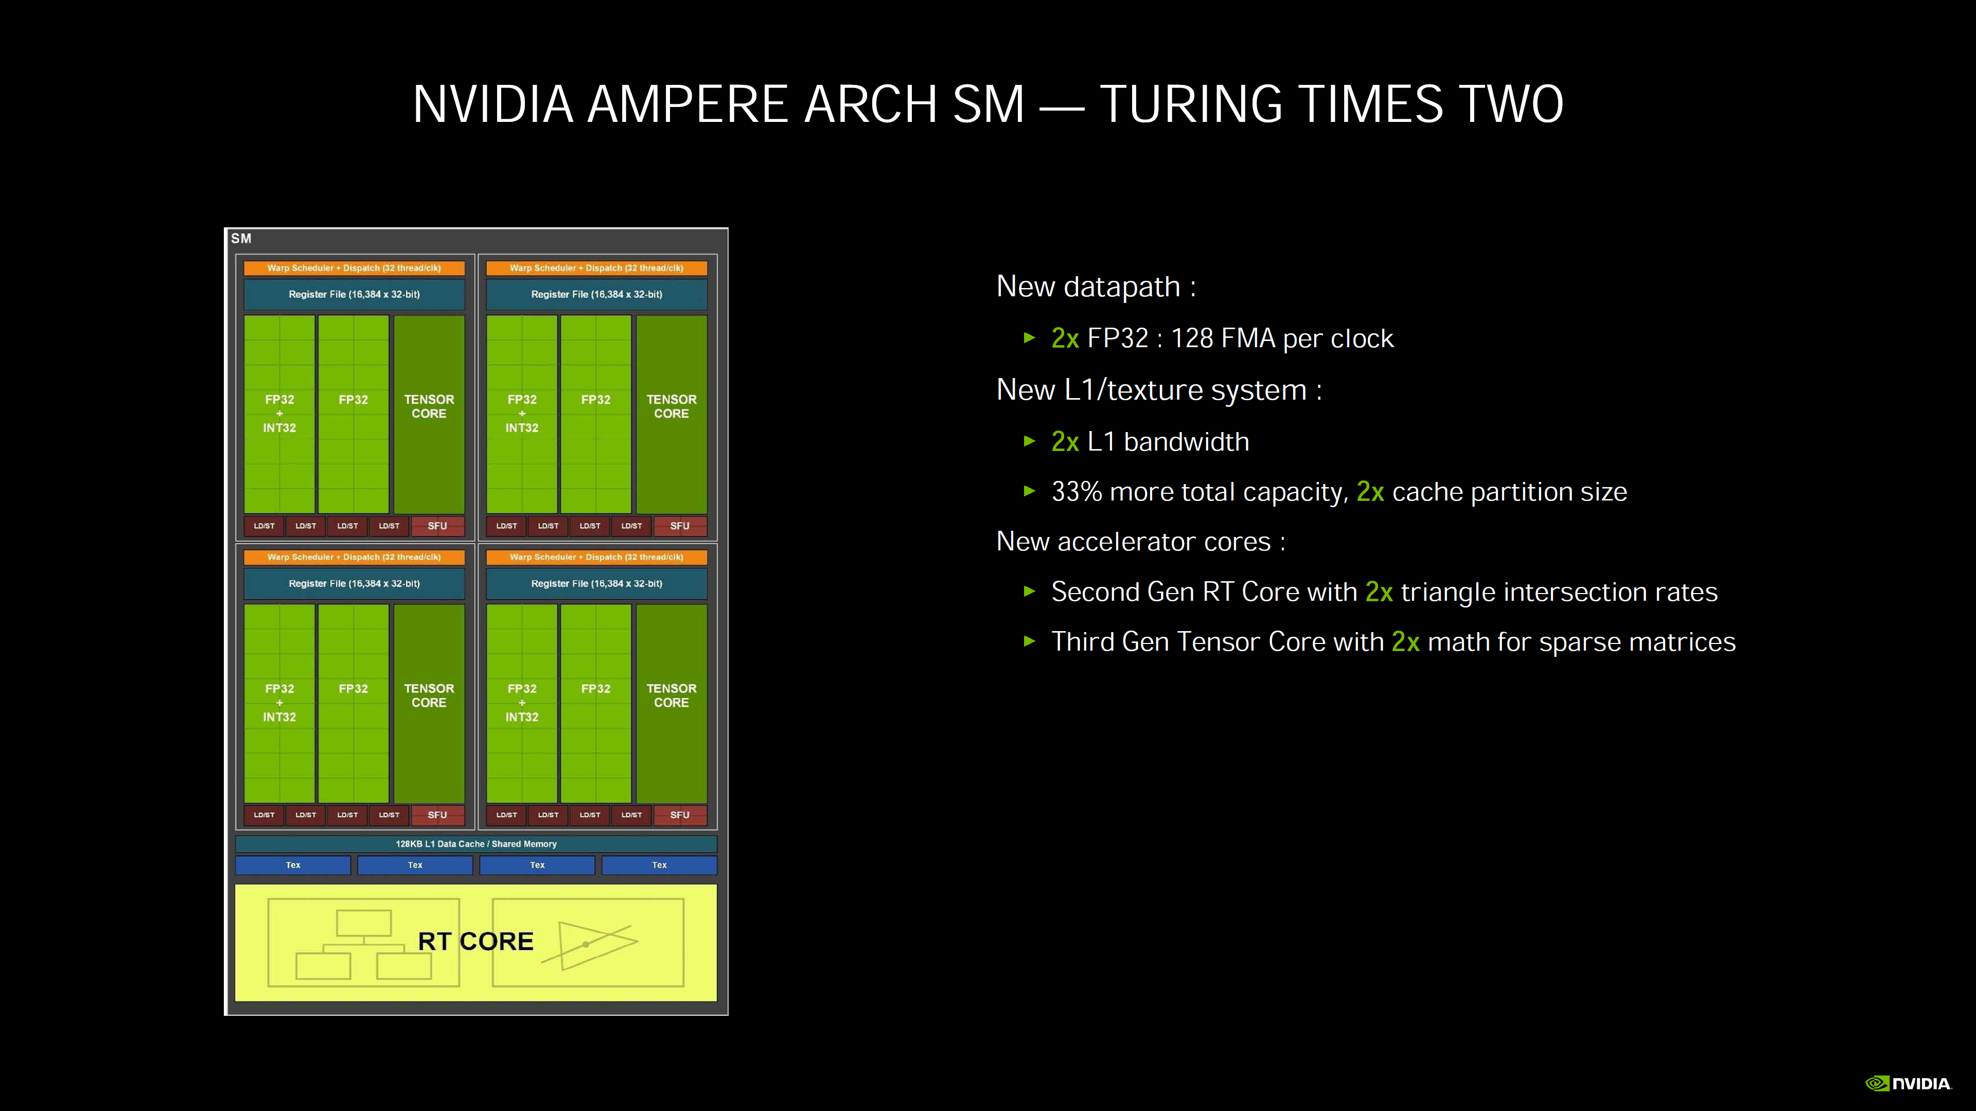

Slide 100
Scheduling Threads
Warp – threads from a block
32 threads
Run on the same SM
Unit of thread scheduling
Consecutive threadIdx values
Notes:
NVIDIA has no intention to change warp size to 32

Slide 101
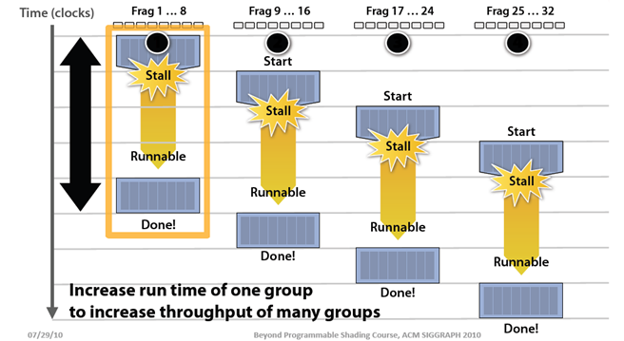
Scheduling Threads
Image from: http://bps10.idav.ucdavis.edu/talks/03-fatahalian_gpuArchTeraflop_BPS_SIGGRAPH2010.pdf
Notes:
When a stall is hit, the scheduler swaps out a warp for another warp that is ready
We want to have enough blocks/warps to handle any stalls (such as reading from global memory)

Slide 102
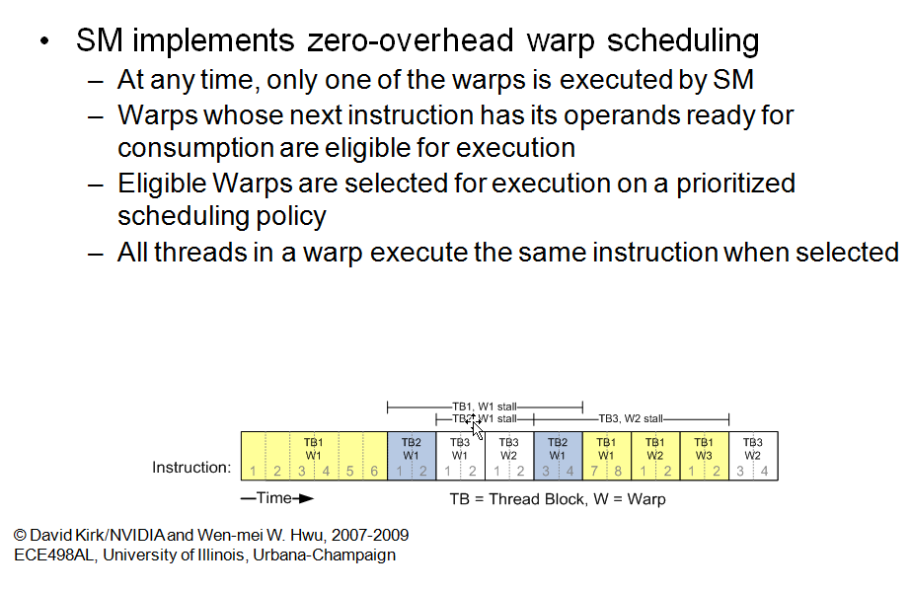
Scheduling Threads
Slide from: http://courses.engr.illinois.edu/ece498/al/Syllabus.html

Slide 103
Scheduling Threads
What happens if branches in a warp diverge?

Slide 104
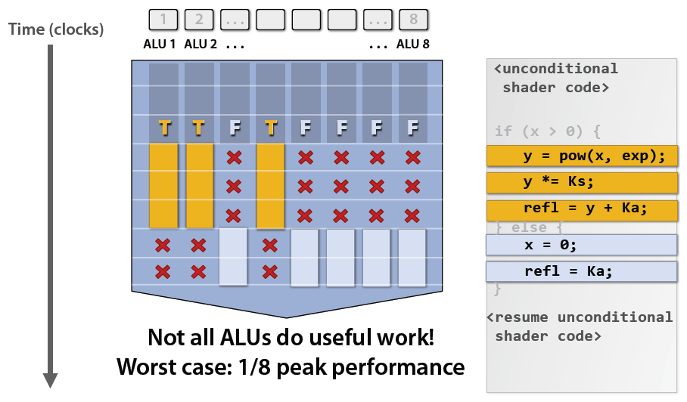
Scheduling Threads
Image from: http://bps10.idav.ucdavis.edu/talks/03-fatahalian_gpuArchTeraflop_BPS_SIGGRAPH2010.pdf

Slide 105
Scheduling Threads
An SM can host up to 1024 threads, how many warps is that?
If 3 blocks are assigned to an SM and each block has 256 threads, how many warps are there?
Notes:
1024 / 32 = 32 warps
(3 * 256) / 32 = 24 warps

Slide 106
Scheduling Threads
Each warp has 4 multiples/adds
16 cycles
We need to cover 200 cycles
200 / 16 = 12.5
ceil(12.5) = 13
13 warps are required
Notes:
Our book says 14 in Section 6.4 (Data Prefetching) on Page 113, but I believe it is a typo.

Slide 107
Memory Model Revisited

Slide 108
Memory Model
Note: We will only cover registers, shared memory, global memory today
Image from: http://courses.engr.illinois.edu/ece498/al/textbook/Chapter2-CudaProgrammingModel.pdf

Slide 109
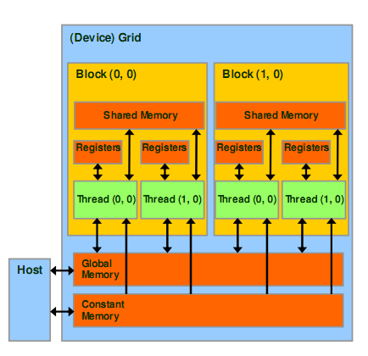
Memory Model
Registers
Per thread
Fast, on-chip, read/write access
Increasing the number of registers used by a kernel has what affect?
Notes:
Potentially decrease the number of threads (well, blocks) available to that SM for scheduling.

Slide 110
Memory Model - Registers
Registers – Example on G80 Architecture
Per SM
Up to 768 threads
8K registers
How many registers per thread?

Slide 111
Memory Model - Registers
Registers - G80
8K / 768 = 10 registers per thread
Exceeding limit reduces threads by the block
Example: Each thread uses 11 registers, and each block has 256 threads
How many threads can a SM host?
How many warps can a SM host?
What does having less warps mean?
Notes:
Host 512 threads (2 blocks instead of 3)
Host 512 / 32 = 16 warps
Instead of 768 threads and 24 warps

Slide 112
Memory Model
Special Registers - Used for built-in variables
threadIdx
blockIdx
blockDim
gridDim

Slide 113
Memory Model – Local Memory
Refers to memory where registers and other thread-data is spilled
Usually when one runs out of SM resources
“Local” because each thread has its own private area
Arrays declared inside kernels (if compiler can’t resolve indexing)
Details:
Not really a “memory” – bytes are stored in global memory
Differences from global memory
Addressing is resolved by the compiler
Stores are cached in L1 (SM 2.x and newer)
http://developer.download.nvidia.com/CUDA/training/register_spilling.pdf

Slide 114
Memory Model – Local Memory
It could hurt performance in two ways:
Increased memory traffic
Increased instruction count
Spilling/LMEM usage isn’t always bad
LMEM bytes can get contained within L1
Avoids memory traffic increase
Additional instructions don’t matter much if code is not instruction-throughput limited
For performance optimization, see link below
http://developer.download.nvidia.com/CUDA/training/register_spilling.pdf

Slide 115
Memory Model – Shared Memory
Shared Memory
Per block
Fast, on-chip, read/write access
Full speed random access

Slide 116
Memory Model – Shared Memory
Shared Memory – Example G80 Architecture
Per SM
Up to 8 blocks
16 KB
How many KB per block
Notes:
2 KB per block

Slide 117
Memory Model – Shared Memory
Shared Memory – G80
16 KB / 8 = 2 KB per block
Example
If each block uses 5 KB, how many blocks can a SM host?
Notes:
16 KB / 5 KB = 3 blocks per SM

Slide 118
Memory Model – Global Memory
Long latency (100s cycles)
Off-chip, read/write access
Random access causes performance hit
Host can read/write
Reads are cached (2.x and newer)
But writes invalidate the cache
GT200
150 GB/s
Up to 4 GB
G80 – 86.4 GB/s
Notes:
Kepler up to 200 GB/s

Slide 119
Memory Model – Constant Memory
Constant Memory
Short latency, high bandwidth, read only access when all threads access the same location
Stored in global memory but cached
Host can read/write
Up to 64 KB

Slide 120
Memory Model – Constant Memory
Global and constant variables
Host can access with
cudaGetSymbolAddress()
cudaGetSymbolSize()
cudaMemcpyToSymbol()
cudaMemcpyFromSymbol()
Constants must be declared outside of a function body
__constant__ float constData[256]; // global scope float data[256]; cudaMemcpyToSymbol(constData, data, sizeof(data)); cudaMemcpyFromSymbol(data, constData, sizeof(data));
Notes:
__constant__ float constData[256];
float data[256];
cudaMemcpyToSymbol(constData, data, sizeof(data));
cudaMemcpyFromSymbol(data, constData, sizeof(data))

Slide 121
Memory Model
Variable Declaration | Memory | Scope | Lifetime
Automatic variables other than arrays | register | thread | kernel
Automatic array variables | local | thread | kernel
__shared__ int sharedVar; | shared | block | kernel
__device__ int globalVar; | global | grid | application
__constant__ int constantVar; | constant | grid | application
See Appendix B.2 in the NVIDIA CUDA C Programming Guide for more details

Slide 122
Thread Synchronization

Slide 123
Thread Synchronization
Threads in a block can synchronize
call to __syncthreads create a barrier
A thread waits at this call until all threads in the block reach it, then all threads continue
Mds[i] = Md[j];
__syncthreads();
func(Mds[i], Mds[i + 1]);

Slide 124
Thread Synchronization
Thread 0
Thread 1
Mds[i] = Md[j];
__syncthreads();
func(Mds[i], Mds[i+1]);
Mds[i] = Md[j];
__syncthreads();
func(Mds[i], Mds[i+1]);
Thread 2
Thread 3
Mds[i] = Md[j];
__syncthreads();
func(Mds[i], Mds[i+1]);
Mds[i] = Md[j];
__syncthreads();
func(Mds[i], Mds[i+1]);
Time: 0
Notes:
In this example, the warp size is 2. The block size is 4.

Slide 125
Thread Synchronization
Thread 0
Thread 1
Mds[i] = Md[j];
__syncthreads();
func(Mds[i], Mds[i+1]);
Mds[i] = Md[j];
__syncthreads();
func(Mds[i], Mds[i+1]);
Thread 2
Thread 3
Mds[i] = Md[j];
__syncthreads();
func(Mds[i], Mds[i+1]);
Mds[i] = Md[j];
__syncthreads();
func(Mds[i], Mds[i+1]);
Time: 1

Slide 126
Thread Synchronization
Thread 0
Thread 1
Mds[i] = Md[j];
__syncthreads();
func(Mds[i], Mds[i+1]);
Mds[i] = Md[j];
__syncthreads();
func(Mds[i], Mds[i+1]);
Thread 2
Thread 3
Mds[i] = Md[j];
__syncthreads();
func(Mds[i], Mds[i+1]);
Mds[i] = Md[j];
__syncthreads();
func(Mds[i], Mds[i+1]);
Threads 0 and 1 are blocked at barrier
Time: 1

Slide 127
Thread Synchronization
Thread 0
Thread 1
Mds[i] = Md[j];
__syncthreads();
func(Mds[i], Mds[i+1]);
Mds[i] = Md[j];
__syncthreads();
func(Mds[i], Mds[i+1]);
Thread 2
Thread 3
Mds[i] = Md[j];
__syncthreads();
func(Mds[i], Mds[i+1]);
Mds[i] = Md[j];
__syncthreads();
func(Mds[i], Mds[i+1]);
Time: 2

Slide 128
Thread Synchronization
Thread 0
Thread 1
Mds[i] = Md[j];
__syncthreads();
func(Mds[i], Mds[i+1]);
Mds[i] = Md[j];
__syncthreads();
func(Mds[i], Mds[i+1]);
Thread 2
Thread 3
Mds[i] = Md[j];
__syncthreads();
func(Mds[i], Mds[i+1]);
Mds[i] = Md[j];
__syncthreads();
func(Mds[i], Mds[i+1]);
Time: 3

Slide 129
Thread Synchronization
Thread 0
Thread 1
Mds[i] = Md[j];
__syncthreads();
func(Mds[i], Mds[i+1]);
Mds[i] = Md[j];
__syncthreads();
func(Mds[i], Mds[i+1]);
Thread 2
Thread 3
Mds[i] = Md[j];
__syncthreads();
func(Mds[i], Mds[i+1]);
Mds[i] = Md[j];
__syncthreads();
func(Mds[i], Mds[i+1]);
All threads in block have reached barrier, any thread can continue
Time: 3

Slide 130
Thread Synchronization
Thread 0
Thread 1
Mds[i] = Md[j];
__syncthreads();
func(Mds[i], Mds[i+1]);
Mds[i] = Md[j];
__syncthreads();
func(Mds[i], Mds[i+1]);
Thread 2
Thread 3
Mds[i] = Md[j];
__syncthreads();
func(Mds[i], Mds[i+1]);
Mds[i] = Md[j];
__syncthreads();
func(Mds[i], Mds[i+1]);
Time: 4

Slide 131
Thread Synchronization
Thread 0
Thread 1
Mds[i] = Md[j];
__syncthreads();
func(Mds[i], Mds[i+1]);
Mds[i] = Md[j];
__syncthreads();
func(Mds[i], Mds[i+1]);
Thread 2
Thread 3
Mds[i] = Md[j];
__syncthreads();
func(Mds[i], Mds[i+1]);
Mds[i] = Md[j];
__syncthreads();
func(Mds[i], Mds[i+1]);
Time: 5

Slide 132
Thread Synchronization
Why is it important that execution time be similar among threads?
Why does it only synchronize within a block?
Notes:
Similar execution time – load balance
Synchronize within a block – runtime can schedule threads in any order

Slide 133
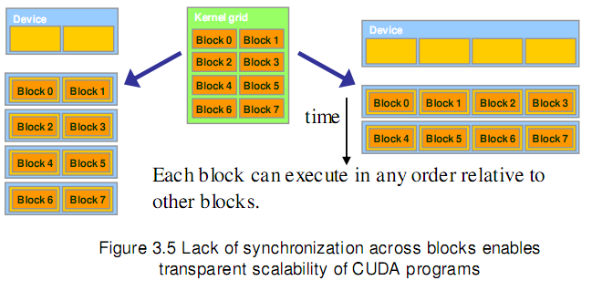
Thread Synchronization
Image from http://courses.engr.illinois.edu/ece498/al/textbook/Chapter3-CudaThreadingModel.pdf

Slide 134
Thread Synchronization
Can __syncthreads() cause a thread to hang?

Slide 135
Thread Synchronization
if (someCondition)
{
__syncthreads();
}
// ...
Notes:
Yes, if not all threads in the block execute the same condition

Slide 136
Thread Synchronization
if (someCondition)
{
__syncthreads();
}
else
{
__syncthreads();
}
Notes:
Yes, if not all threads in the block execute the same condition

Slide 137
Let’s Revisit Matrix Multiply

Slide 138
Matrix Multiply: CPU Implementation
void MatrixMultiplyOnHost(float* M, float* N, float* P, int width)‏
{
for (int i = 0; i < width; ++i)‏
{
for (int j = 0; j < width; ++j)
{
float sum = 0;
for (int k = 0; k < width; ++k)
{
float a = M[i * width + k];
float b = N[k * width + j];
sum += a * b;
}
P[i * width + j] = sum;
}
}
}
Code from: http://courses.engr.illinois.edu/ece498/al/lectures/lecture3%20cuda%20threads%20spring%202010.ppt
Notes:
Row major. The inner most loop goes across a row of M, and down a column of N.

Slide 139
Matrix Multiply: CUDA Kernel
__global__ void MatrixMultiplyKernel(const float* devM, const float* devN,
float* devP, const int width)
{
int tx = threadIdx.x;
int ty = threadIdx.y;
// Initialize accumulator to 0
float pValue = 0;
// Multiply and add
for (int k = 0; k < width; k++) {
float m = devM[ty * width + k];
float n = devN[k * width + tx];
pValue += m * n;
}
// Write value to device memory - each thread has unique index to write to
devP[ty * width + tx] = pValue;
}

Slide 140
Matrix Multiply: CUDA Kernel
__global__ void MatrixMultiplyKernel(const float* devM, const float* devN,
float* devP, const int width)
{
int tx = threadIdx.x;
int ty = threadIdx.y;
// Initialize accumulator to 0
float pValue = 0;
// Multiply and add
for (int k = 0; k < width; k++) {
float m = devM[ty * width + k];
float n = devN[k * width + tx];
pValue += m * n;
}
// Write value to device memory - each thread has unique index to write to
devP[ty * width + tx] = pValue;
}
Kernel specifier
Specify const buffers
for read-only
Always void
No const for buffers that will be written to

Slide 141
Matrix Multiply: CUDA Kernel
__global__ void MatrixMultiplyKernel(const float* devM, const float* devN,
float* devP, const int width)
{
int tx = threadIdx.x;
int ty = threadIdx.y;
// Initialize accumulator to 0
float pValue = 0;
// Multiply and add
for (int k = 0; k < width; k++) {
float m = devM[ty * width + k];
float n = devN[k * width + tx];
pValue += m * n;
}
// Write value to device memory - each thread has unique index to write to
devP[ty * width + tx] = pValue;
}
Accessing a Matrix, use 2D threads

Slide 142
Matrix Multiply: CUDA Kernel
__global__ void MatrixMultiplyKernel(const float* devM, const float* devN,
float* devP, const int width)
{
int tx = threadIdx.x;
int ty = threadIdx.y;
// Initialize accumulator to 0
float pValue = 0;
// Multiply and add
for (int k = 0; k < width; k++) {
float m = devM[ty * width + k];
float n = devN[k * width + tx];
pValue += m * n;
}
// Write value to device memory - each thread has unique index to write to
devP[ty * width + tx] = pValue;
}
Each kernel thread computes one location of the matrix

Slide 143
Matrix Multiply: CUDA Kernel
__global__ void MatrixMultiplyKernel(const float* devM, const float* devN,
float* devP, const int width)
{
int tx = threadIdx.x;
int ty = threadIdx.y;
// Initialize accumulator to 0
float pValue = 0;
// Multiply and add
for (int k = 0; k < width; k++) {
float m = devM[ty * width + k];
float n = devN[k * width + tx];
pValue += m * n;
}
// Write value to device memory - each thread has unique index to write to
devP[ty * width + tx] = pValue;
}
What happened to the 2 outer loops?

Slide 144
Matrix Multiply: CUDA Kernel
__global__ void MatrixMultiplyKernel(const float* devM, const float* devN,
float* devP, const int width)
{
int tx = threadIdx.x;
int ty = threadIdx.y;
// Initialize accumulator to 0
float pValue = 0;
// Multiply and add
for (int k = 0; k < width; k++) {
float m = devM[ty * width + k];
float n = devN[k * width + tx];
pValue += m * n;
}
// Write value to device memory - each thread has unique index to write to
devP[ty * width + tx] = pValue;
}
2D Matrix but 1D access

Slide 145
Matrix Multiply: CUDA Kernel
__global__ void MatrixMultiplyKernel(const float* devM, const float* devN,
float* devP, const int width)
{
int tx = threadIdx.x;
int ty = threadIdx.y;
// Initialize accumulator to 0
float pValue = 0;
// Multiply and add
for (int k = 0; k < width; k++) {
float m = devM[ty * width + k];
float n = devN[k * width + tx];
pValue += m * n;
}
// Write value to device memory - each thread has unique index to write to
devP[ty * width + tx] = pValue;
}
Are we missing synchronization? Why?

Slide 146
Matrix Multiply: CUDA Kernel
__global__ void MatrixMultiplyKernel(const float* devM, const float* devN,
float* devP, const int width)
{
int tx = threadIdx.x;
int ty = threadIdx.y;
// Initialize accumulator to 0
float pValue = 0;
// Multiply and add
for (int k = 0; k < width; k++) {
float m = devM[ty * width + k];
float n = devN[k * width + tx];
pValue += m * n;
}
// Write value to device memory - each thread has unique index to write to
devP[ty * width + tx] = pValue;
}
Write the value to the correct output index.

Slide 147
Matrix Multiply
Problems
Limited matrix size
Only uses one block
Lots of global memory access

Slide 148
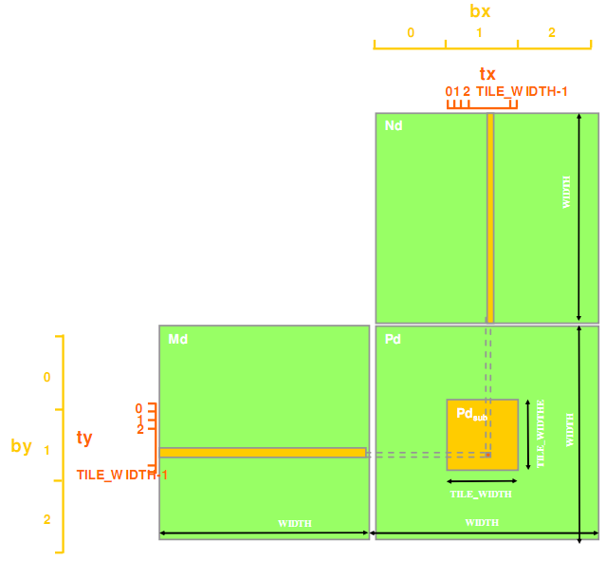
Matrix Multiply
Remove size limitation
Break Pd matrix into tiles
Assign each tile to a block
Use threadIdx and blockIdx for indexing
Image from http://courses.engr.illinois.edu/ece498/al/textbook/Chapter3-CudaThreadingModel.pdf

Slide 149
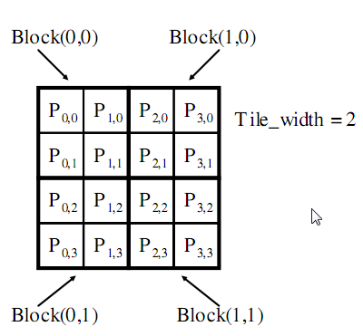
Matrix Multiply
Example
Matrix: 4x4
TILE_WIDTH = 2
Block size: 2x2
Image from http://courses.engr.illinois.edu/ece498/al/textbook/Chapter3-CudaThreadingModel.pdf

Slide 150
Matrix Multiply
Nd_{0,0} | Nd_{1,0} | Nd_{2,0} | Nd_{3,0}
Nd_{0,1} | Nd_{1,1} | Nd_{2,1} | Nd_{3,1}
Nd_{0,2} | Nd_{1,2} | Nd_{2,1} | Nd_{3,2}
Nd_{0,3} | Nd_{1,3} | Nd_{2,3} | Nd_{3,3}
Example
Matrix: 4x4
TILE_WIDTH = 2
Block size: 2x2
Md_{0,0} | Md_{1,0} | Md_{2,0} | Md_{3,0}
Md_{0,1} | Md_{1,1} | Md_{2,1} | Md_{3,1}
Md_{0,2} | Md_{1,2} | Md_{2,1} | Md_{3,2}
Md_{0,3} | Md_{1,3} | Md_{2,3} | Md_{3,3}
Pd_{0,0} | Pd_{1,0} | Pd_{2,0} | Pd_{3,0}
Pd_{0,1} | Pd_{1,1} | Pd_{2,1} | Pd_{3,1}
Pd_{0,2} | Pd_{1,2} | Pd_{2,1} | Pd_{3,2}
Pd_{0,3} | Pd_{1,3} | Pd_{2,3} | Pd_{3,3}
Image from http://courses.engr.illinois.edu/ece498/al/Syllabus.html
Notes:
When we use tilewidth = 2, when we calculate 2x2 elements of the product matrix using a single thread

Slide 151
Matrix Multiply
__global__ void MatrixMultiplyKernel(const float* devM, const float* devN,
float* devP, const int width)
{
int col = blockIdx.x * blockDim.x + threadIdx.x;
int row = blockIdx.y * blockDim.y + threadIdx.y;
// Initialize accumulator to 0
float pValue = 0;
// Multiply and add
for (int k = 0; k < width; k++) {
float m = ;
float n = ;
pValue += devM[row * width + k] * devN[k * width + col];
}
// Write value to device memory - each thread has unique index to write to
devP[row * width + col] = pValue;
}
Code from http://courses.engr.illinois.edu/ece498/al/Syllabus.html

Slide 152
Matrix Multiply
__global__ void MatrixMultiplyKernel(const float* devM, const float* devN,
float* devP, const int width)
{
int col = blockIdx.x * blockDim.x + threadIdx.x;
int row = blockIdx.y * blockDim.y + threadIdx.y;
// Initialize accumulator to 0
float pValue = 0;
// Multiply and add
for (int k = 0; k < width; k++) {
float m = ;
float n = ;
pValue += devM[row * width + k] * devN[k * width + col];
}
// Write value to device memory - each thread has unique index to write to
devP[row * width + col] = pValue;
}
Calculate row index of P and M
Code from http://courses.engr.illinois.edu/ece498/al/Syllabus.html

Slide 153
Matrix Multiply
__global__ void MatrixMultiplyKernel(const float* devM, const float* devN,
float* devP, const int width)
{
int col = blockIdx.x * blockDim.x + threadIdx.x;
int row = blockIdx.y * blockDim.y + threadIdx.y;
// Initialize accumulator to 0
float pValue = 0;
// Multiply and add
for (int k = 0; k < width; k++) {
float m = ;
float n = ;
pValue += devM[row * width + k] * devN[k * width + col];
}
// Write value to device memory - each thread has unique index to write to
devP[row * width + col] = pValue;
}
Calculate col index of P and N
Code from http://courses.engr.illinois.edu/ece498/al/Syllabus.html

Slide 154
Matrix Multiply
__global__ void MatrixMultiplyKernel(const float* devM, const float* devN,
float* devP, const int width)
{
int col = blockIdx.x * blockDim.x + threadIdx.x;
int row = blockIdx.y * blockDim.y + threadIdx.y;
// Initialize accumulator to 0
float pValue = 0;
// Multiply and add
for (int k = 0; k < width; k++) {
float m = ;
float n = ;
pValue += devM[row * width + k] * devN[k * width + col];
}
// Write value to device memory - each thread has unique index to write to
devP[row * width + col] = pValue;
}
Each thread computes 1 element of P sub-matrix
Code from http://courses.engr.illinois.edu/ece498/al/Syllabus.html

Slide 155
Matrix Multiply
__global__ void MatrixMultiplyKernel(const float* devM, const float* devN,
float* devP, const int width)
{
int col = blockIdx.x * blockDim.x + threadIdx.x;
int row = blockIdx.y * blockDim.y + threadIdx.y;
// Initialize accumulator to 0
float pValue = 0;
// Multiply and add
for (int k = 0; k < width; k++) {
float m = ;
float n = ;
pValue += devM[row * width + k] * devN[k * width + col];
}
// Write value to device memory - each thread has unique index to write to
devP[row * width + col] = pValue;
}
Write value to devP
Code from http://courses.engr.illinois.edu/ece498/al/Syllabus.html

Slide 156
Matrix Multiply: Invoke Kernel
void MatrixMultiplyOnDevice(float* hostP,
const float* hostM, const float* hostN, const int width)
{
………
// Allocate P on device
cudaMalloc((void**)&devP, sizeInBytes);
// Call the kernel here
// Copy P matrix from device to host
cudaMemcpy(hostP, devP, sizeInBytes, cudaMemcpyDeviceToHost);
………
}
Each block has (width, width) threads
// Setup thread/block execution configuration
dim3 dimBlocks(TILE_WIDTH, TILE_WIDTH);
dim3 dimGrid(WIDTH / TILE_WIDTH, WIDTH / TILE_WIDTH);
// Launch the kernel
MatrixMultiplyKernel<<<dimGrid, dimBlocks>>>(devM, devN, devP, width);
Launch multiple block

Slide 157
What about global memory access?

Slide 158
Matrix Multiply
Limited by global memory bandwidth
G80 peak GFLOPS: 346.5
Require 1386 GB/s to achieve this
G80 memory bandwidth: 86.4 GB/s
Limits code to 21.6 GFLOPS
In practice, code runs at 15 GFLOPS
Must drastically reduce global memory access

Slide 159
Matrix Multiply
Each input element is read by Width threads
Use shared memory to reduce global memory bandwidth
N
WIDTH
M
P
ty
WIDTH
tx
WIDTH
WIDTH
Image from http://courses.engr.illinois.edu/ece498/al/Syllabus.html

Slide 160
Matrix Multiply
BX
0
1
2
TX
Break kernel into phases
Each phase accumulates Pd using a subset of Md and Nd
Each phase has good data locality
0 1 2 TILE_WIDTH - 1
Nd
Tile
Width
Tile
Width
Width
Md
Pd
0
1
2
BY
TY
0
1
2
Tile
Width
Width
TILE_WIDTH - 1
Tile
Width
Tile
Width
Tile
Width
Width
Width
Image from http://courses.engr.illinois.edu/ece498/al/Syllabus.html

Slide 161
Matrix Multiply
BX
0
1
2
TX
Each thread
loads one element of Md and Nd in the tile into shared memory
0 1 2 TILE_WIDTH - 1
Nd
m
Tile
Width
bx
k
Tile
Width
Width
Md
Pd
by
m
0
1
2
BY
TY
k
0
1
2
Tile
Width
Width
TILE_WIDTH - 1
Tile
Width
Tile
Width
Tile
Width
Width
Width
Image from http://courses.engr.illinois.edu/ece498/al/Syllabus.html

Slide 162
__global__ void MatrixMultiplyKernel(const float* devM, const float* devN,
float* devP, const int width)
{
__shared__ float sM[TILE_WIDTH][TILE_WIDTH];
__shared__ float sN[TILE_WIDTH][TILE_WIDTH];
int bx = blockIdx.x; int by = blockIdx.y;
int tx = threadIdx.x; int ty = threadIdx.y;
int col = bx * TILE_WIDTH + tx;
int row = by * TILE_WIDTH + ty;
// Initialize accumulator to 0
float pValue = 0;
// Multiply and add
for (int m = 0; m < width / TILE_WIDTH; m++) {
sM[ty][tx] = devM[row * width + (m * TILE_WIDTH + tx)];
sN[ty][tx] = devN[col + (m * TILE_WIDTH + ty) * Width];
__syncthreads();
for (int k = 0; k < TILE_WIDTH; ++k)
Pvalue += sM[ty][k] * sN[k][tx];
__synchthreads();
}
devP[row * width + col] = pValue;
}
Code from http://courses.engr.illinois.edu/ece498/al/Syllabus.html

Slide 163
__global__ void MatrixMultiplyKernel(const float* devM, const float* devN,
float* devP, const int width)
{
__shared__ float sM[TILE_WIDTH][TILE_WIDTH];
__shared__ float sN[TILE_WIDTH][TILE_WIDTH];
int bx = blockIdx.x; int by = blockIdx.y;
int tx = threadIdx.x; int ty = threadIdx.y;
int col = bx * TILE_WIDTH + tx;
int row = by * TILE_WIDTH + ty;
// Initialize accumulator to 0
float pValue = 0;
// Multiply and add
for (int m = 0; m < width / TILE_WIDTH; m++) {
sM[ty][tx] = devM[row * width + (m * TILE_WIDTH + tx)];
sN[ty][tx] = devN[col + (m * TILE_WIDTH + ty) * Width];
__syncthreads();
for (int k = 0; k < TILE_WIDTH; ++k)
Pvalue += sM[ty][k] * sN[k][tx];
__synchthreads();
}
devP[row * width + col] = pValue;
}
Shared memory of M and N submatrices
Code from http://courses.engr.illinois.edu/ece498/al/Syllabus.html

Slide 164
__global__ void MatrixMultiplyKernel(const float* devM, const float* devN,
float* devP, const int width)
{
__shared__ float sM[TILE_WIDTH][TILE_WIDTH];
__shared__ float sN[TILE_WIDTH][TILE_WIDTH];
int bx = blockIdx.x; int by = blockIdx.y;
int tx = threadIdx.x; int ty = threadIdx.y;
int col = bx * TILE_WIDTH + tx;
int row = by * TILE_WIDTH + ty;
// Initialize accumulator to 0
float pValue = 0;
// Multiply and add
for (int m = 0; m < width / TILE_WIDTH; m++) {
sM[ty][tx] = devM[row * width + (m * TILE_WIDTH + tx)];
sN[ty][tx] = devN[col + (m * TILE_WIDTH + ty) * Width];
__syncthreads();
for (int k = 0; k < TILE_WIDTH; ++k)
Pvalue += sM[ty][k] * sN[k][tx];
__synchthreads();
}
devP[row * width + col] = pValue;
}
Store blockIdx/ThreadIdx before calculating row and col
Code from http://courses.engr.illinois.edu/ece498/al/Syllabus.html

Slide 165
__global__ void MatrixMultiplyKernel(const float* devM, const float* devN,
float* devP, const int width)
{
__shared__ float sM[TILE_WIDTH][TILE_WIDTH];
__shared__ float sN[TILE_WIDTH][TILE_WIDTH];
int bx = blockIdx.x; int by = blockIdx.y;
int tx = threadIdx.x; int ty = threadIdx.y;
int col = bx * TILE_WIDTH + tx;
int row = by * TILE_WIDTH + ty;
// Initialize accumulator to 0
float pValue = 0;
// Multiply and add
for (int m = 0; m < width / TILE_WIDTH; m++) {
sM[ty][tx] = devM[row * width + (m * TILE_WIDTH + tx)];
sN[ty][tx] = devN[col + (m * TILE_WIDTH + ty) * Width];
__syncthreads();
for (int k = 0; k < TILE_WIDTH; ++k)
Pvalue += sM[ty][k] * sN[k][tx];
__synchthreads();
}
devP[row * width + col] = pValue;
}
m is index of current phase
This is the number of phases to iterate
Code from http://courses.engr.illinois.edu/ece498/al/Syllabus.html

Slide 166
__global__ void MatrixMultiplyKernel(const float* devM, const float* devN,
float* devP, const int width)
{
__shared__ float sM[TILE_WIDTH][TILE_WIDTH];
__shared__ float sN[TILE_WIDTH][TILE_WIDTH];
int bx = blockIdx.x; int by = blockIdx.y;
int tx = threadIdx.x; int ty = threadIdx.y;
int col = bx * TILE_WIDTH + tx;
int row = by * TILE_WIDTH + ty;
// Initialize accumulator to 0
float pValue = 0;
// Multiply and add
for (int m = 0; m < width / TILE_WIDTH; m++) {
sM[ty][tx] = devM[row * width + (m * TILE_WIDTH + tx)];
sN[ty][tx] = devN[col + (m * TILE_WIDTH + ty) * Width];
__syncthreads();
for (int k = 0; k < TILE_WIDTH; ++k)
Pvalue += sM[ty][k] * sN[k][tx];
__synchthreads();
}
devP[row * width + col] = pValue;
}
Bring one element from each devM and devN into shared memory
Code from http://courses.engr.illinois.edu/ece498/al/Syllabus.html

Slide 167
__global__ void MatrixMultiplyKernel(const float* devM, const float* devN,
float* devP, const int width)
{
__shared__ float sM[TILE_WIDTH][TILE_WIDTH];
__shared__ float sN[TILE_WIDTH][TILE_WIDTH];
int bx = blockIdx.x; int by = blockIdx.y;
int tx = threadIdx.x; int ty = threadIdx.y;
int col = bx * TILE_WIDTH + tx;
int row = by * TILE_WIDTH + ty;
// Initialize accumulator to 0
float pValue = 0;
// Multiply and add
for (int m = 0; m < width / TILE_WIDTH; m++) {
sM[ty][tx] = devM[row * width + (m * TILE_WIDTH + tx)];
sN[ty][tx] = devN[col + (m * TILE_WIDTH + ty) * Width];
__syncthreads();
for (int k = 0; k < TILE_WIDTH; ++k)
pValue += sM[ty][k] * sN[k][tx];
__synchthreads();
}
devP[row * width + col] = pValue;
}
Accumulate subset of dot product
Code from http://courses.engr.illinois.edu/ece498/al/Syllabus.html

Slide 168
__global__ void MatrixMultiplyKernel(const float* devM, const float* devN,
float* devP, const int width)
{
__shared__ float sM[TILE_WIDTH][TILE_WIDTH];
__shared__ float sN[TILE_WIDTH][TILE_WIDTH];
int bx = blockIdx.x; int by = blockIdx.y;
int tx = threadIdx.x; int ty = threadIdx.y;
int col = bx * TILE_WIDTH + tx;
int row = by * TILE_WIDTH + ty;
// Initialize accumulator to 0
float pValue = 0;
// Multiply and add
for (int m = 0; m < width / TILE_WIDTH; m++) {
sM[ty][tx] = devM[row * width + (m * TILE_WIDTH + tx)];
sN[ty][tx] = devN[col + (m * TILE_WIDTH + ty) * Width];
__syncthreads();
for (int k = 0; k < TILE_WIDTH; ++k)
pValue += sM[ty][k] * sN[k][tx];
__synchthreads();
}
devP[row * width + col] = pValue;
}
Why
Code from http://courses.engr.illinois.edu/ece498/al/Syllabus.html
Notes:
Need to sync the entire block after write

Slide 169
__global__ void MatrixMultiplyKernel(const float* devM, const float* devN,
float* devP, const int width)
{
__shared__ float sM[TILE_WIDTH][TILE_WIDTH];
__shared__ float sN[TILE_WIDTH][TILE_WIDTH];
int bx = blockIdx.x; int by = blockIdx.y;
int tx = threadIdx.x; int ty = threadIdx.y;
int col = bx * TILE_WIDTH + tx;
int row = by * TILE_WIDTH + ty;
// Initialize accumulator to 0
float pValue = 0;
// Multiply and add
for (int m = 0; m < width / TILE_WIDTH; m++) {
sM[ty][tx] = devM[row * width + (m * TILE_WIDTH + tx)];
sN[ty][tx] = devN[col + (m * TILE_WIDTH + ty) * Width];
__syncthreads();
for (int k = 0; k < TILE_WIDTH; ++k)
pValue += sM[ty][k] * sN[k][tx];
__synchthreads();
}
devP[row * width + col] = pValue;
}
Write final answer to global memory
Code from http://courses.engr.illinois.edu/ece498/al/Syllabus.html
Notes:
Need to sync the entire block after write

Slide 170
Matrix Multiply
How do you pick TILE_WIDTH?
How can it be too large?

Slide 171
Matrix Multiply
How do you pick TILE_WIDTH?
How can it be too large?
By exceeding the maximum number of threads/block

Slide 172
Matrix Multiply
How do you pick TILE_WIDTH?
How can it be too large?
By exceeding the maximum number of threads/block
By exceeding the shared memory limitations
G80: 16KB per SM and up to 8 blocks per SM
2 KB per block
1 KB for Nds and 1 KB for Mds (16 * 16 * 4)
TILE_WIDTH = 16
A larger TILE_WIDTH will result in less blocks

Slide 173
Matrix Multiply
Shared memory tiling benefits
Reduces global memory access by a factor of TILE_WIDTH
16x16 tiles reduces by a factor of 16
G80
Now global memory supports 345.6 GFLOPS
Close to maximum of 346.5 GFLOPS

Slide 174
Math Functions
double and float overloads
On the host, functions use the C runtime implementation if available
https://docs.nvidia.com/cuda/cuda-math-api/index.html
Notes:
On the device, SFU are likely used.

Slide 175
Math Functions
Partial list:
sqrt, rsqrt
exp, log
sin, cos, tan, sincos
asin, acos, atan2
trunc, ceil, floor
https://docs.nvidia.com/cuda/cuda-math-api/group__CUDA__MATH__SINGLE.html#group__CUDA__MATH__SINGLE

Slide 176
Math Functions
Intrinsic function
Device only
Faster, but less accurate
Prefixed with __ (double underscore)
__exp, __log, __sin, __pow, …
https://docs.nvidia.com/cuda/cuda-math-api/group__CUDA__MATH__INTRINSIC__SINGLE.html#group__CUDA__MATH__INTRINSIC__SINGLE

Slide 177
Vector Types
char[1–4], uchar[1–4]
short[1–4], ushort[1–4]
int[1–4], uint[1–4]
long[1–4], ulong[1–4]
longlong[1–4], ulonglong[1–4]
float[1–4]
double1, double2
Notes:
Notes for 2019: Move vector types to different slide deck

Slide 178
Vector Types
Available in host and device code
Construct with make_<type name>
Vector types (float4) are faster than regular static arrays (float [4])
int2 i2 = make_int2(1, 2);
float4 f4 = make_float4(1.0f, 2.0f, 3.0f, 4.0f);
Notes:
Vector types are faster because the compiler can better optimize memory operations

Slide 179
Vector Types
Access with .x, .y, .z, and .w
int2 i2 = make_int2(1, 2);
int x = i2.x;
int y = i2.y;

Slide 180
CUDA Libraries
https://developer.nvidia.com/gpu-accelerated-libraries

Slide 181
CUDA Libraries – NVIDIA CUDA-X
NVIDIA CUDA-X - collection of libraries for multiple application domains, from artificial intelligence (AI) to high performance computing (HPC).
Math, Algorithms, Image and Video, Deep Learning…
Get the most optimized algorithms
Optimized by experts
No need to write any kernel
https://developer.nvidia.com/gpu-accelerated-libraries

Slide 182
CUDA Libraries
How many of you have used a library like:
BLAS (OpenBLAS etc)
FFTW
LAPACK
Intel MKL
FFMPEG

Slide 183
CUDA Libraries
cuBLAS – GPU accelerated BLAS
cuFFT – GPU accelerated FFT
cuSOLVER – dense and sparse solvers
cuSPARSE – BLAS for sparse
cuTENSOR – Tensor linear algebra library
CUDA Math – GPU math functions
cuDNN – Library of primitives for deep neural networks
TensorRT – Inference optimizer and runtime deployment
DALI – Decoding and augmenting images and videos
(Not exhaustive list)

Slide 184
Thrust

Slide 185
What is Thrust?
Open source High-Level Parallel Algorithms Library
Parallel Analog of the C++ Standard Template Library (STL)
Performance-Portable Abstraction Layer
Productive way to program CUDA
http://developer.download.nvidia.com/compute/developertrainingmaterials/presentations/cuda_language/Introduction_to_Thrust.pptx

Slide 186
For a review of C++ STL and Thrust Similarities, see: http://cs.boisestate.edu/~alark/thrust_intro/presentation.html#slide1

Slide 187
Example - Sort
#include <thrust/host_vector.h>
#include <thrust/device_vector.h>
#include <thrust/sort.h>
#include <cstdlib>
int main(void)
{
// generate 32M random numbers on the host
thrust::host_vector<int> h_vec(32 << 20);
thrust::generate(h_vec.begin(), h_vec.end(), rand);
// transfer data to the device
thrust::device_vector<int> d_vec = h_vec;
// sort data on the device
thrust::sort(d_vec.begin(), d_vec.end());
// transfer data back to host
thrust::copy(d_vec.begin(), d_vec.end(), h_vec.begin());
return 0;
}
http://developer.download.nvidia.com/compute/developertrainingmaterials/presentations/cuda_language/Introduction_to_Thrust.pptx

Slide 188
Example - Reduce
#include <thrust/host_vector.h>
#include <thrust/device_vector.h>
#include <thrust/generate.h>
#include <thrust/reduce.h>
#include <thrust/functional.h>
#include <algorithm>
#include <cstdlib>
int main(void)
{
// generate random data serially
thrust::host_vector<int> h_vec(100);
std::generate(h_vec.begin(), h_vec.end(), rand);
// transfer to device and compute sum
thrust::device_vector<int> d_vec = h_vec;
int x = thrust::reduce(d_vec.begin(), d_vec.end(), 0, thrust::plus<int>());
return 0;
}
http://developer.download.nvidia.com/compute/developertrainingmaterials/presentations/cuda_language/Introduction_to_Thrust.pptx

Slide 189
Easy to Use
Distributed with CUDA Toolkit
Header-only library
Architecture agnostic
Just compile and run!
$ nvcc -O2 -arch=sm_20 program.cu -o program
http://developer.download.nvidia.com/compute/developertrainingmaterials/presentations/cuda_language/Introduction_to_Thrust.pptx

Slide 190
Why should I use Thrust?

Slide 191
Productivity
Containers
host_vector
device_vector
Memory Management
Allocation
Transfers
Algorithm Selection
Location is implicit
// allocate host vector with two elements
thrust::host_vector<int> h_vec(2);
// copy host data to device memory
thrust::device_vector<int> d_vec = h_vec;
// write device values from the host
d_vec[0] = 27;
d_vec[1] = 13;
// read device values from the host
int sum = d_vec[0] + d_vec[1];
// invoke algorithm on device
thrust::sort(d_vec.begin(), d_vec.end());
// memory automatically released
http://developer.download.nvidia.com/compute/developertrainingmaterials/presentations/cuda_language/Introduction_to_Thrust.pptx

Slide 192
Thrust - Memory
With raw CUDA, you have to deal with a lot of low-level memory management.
With Thrust, let the library do the work for you.
cudaMalloc(void ** devPtr, size_t size);
cudaMemcpy(void * dst, void * src, size_t size, direction);
cudaFree(void * devPtr);
// ...
thrust::host_vector<int> h_nums(1024);
thrust::device_vector<int> d_nums;
// copy from host to device
d_nums = h_nums; // calls cudaMemcpy in background
// do some number crunching on the GPU…
// copy from device to host
h_nums = d_nums;
http://cs.boisestate.edu/~alark/thrust_intro/presentation.html#slide17

Slide 193
Productivity
Large set of algorithms
~75 functions
~125 variations
Flexible
User-defined types
User-defined operators
Algorithm | Description
reduce | Sum of a sequence
find | First position of a value in a sequence
mismatch | First position where two sequences differ
inner_product | Dot product of two sequences
equal | Whether two sequences are equal
min_element | Position of the smallest value
count | Number of instances of a value
is_sorted | Whether sequence is in sorted order
transform_reduce | Sum of transformed sequence
http://developer.download.nvidia.com/compute/developertrainingmaterials/presentations/cuda_language/Introduction_to_Thrust.pptx

Slide 194
Thurst – Template Algorithms
With raw CUDA, you have to manage
Grid and Block dimensions
Optimal launch parameters for hardware
Other memory and related factors
// call some device code
add_some_vectors<<<dim3 gridSize, dim3 blockSize>>>(
int *in1, int *in2, int *out
);

Slide 195
Thurst – Template Algorithms
With Thrust, use template algorithms!
Logic for grid/block dimensions is contained in the library, so let it make smart guesses on what to use.
thrust::device_vector<int> d_src1, d_src2, d_dst;
thrust::transform(d_src1.begin(), d_src1.end(),
d_src2.begin(),
d_dst.begin(),
addFunc); // functor!

Slide 196
Thurst – Template Algorithms
Many built-in algorithms to use on the GPU
Most of the algorithms are modeled after the STL algorithms for familiarity.
thrust::find(begin, end, value);
thrust::find_if(begin, end, Predicate);
thrust::copy(src_begin, src_end, dst_begin);
thrust::copy_if(src_begin, src_end, dst_begin, Predicate);
thrust::count(begin, end, value);
thrust::count_if(begin, end, Predicate);
thrust::equal(src1_begin, src1_end, src2_begin);
thrust::min_element(begin, end, [Cmp])
thrust::max_element(begin, end, [Cmp])
thrust::merge(src1_begin, src1_end, src2_begin, src2_end, dst_begin);
thrust::sort(begin, end, [Cmp])
// Map/Reduce (transform === map)
thrust::transform(src1_begin, src1_end, src2_begin,
dst_begin, BinaryOp);
thrust::reduce(begin, end, init, BinaryOp);
// ... and many more ...

Slide 197
Interoperability
Thrust
CUDA C/C++
CUBLAS, CUFFT, NPP
STL
CUDA Fortran
C/C++
OpenMP
TBB
http://developer.download.nvidia.com/compute/developertrainingmaterials/presentations/cuda_language/Introduction_to_Thrust.pptx

Slide 198
Portability
Support for CUDA, TBB and OpenMP
Just recompile!
nvcc -DTHRUST_DEVICE_SYSTEM=THRUST_HOST_SYSTEM_OMP
GeForce GTX 280
$ time ./monte_carlo
pi is approximately 3.14159
real 0m6.190s
user 0m6.052s
sys 0m0.116s
NVIDA GeForce GTX 580
Core2 Quad Q6600
$ time ./monte_carlo
pi is approximately 3.14159
real 1m26.217s
user 11m28.383s
sys 0m0.020s
Intel Core i7 2600K
http://developer.download.nvidia.com/compute/developertrainingmaterials/presentations/cuda_language/Introduction_to_Thrust.pptx

Slide 199
Backend System Options
Host Systems
THRUST_HOST_SYSTEM_CPP
THRUST_HOST_SYSTEM_OMP
THRUST_HOST_SYSTEM_TBB
Device Systems
THRUST_DEVICE_SYSTEM_CUDA
THRUST_DEVICE_SYSTEM_OMP
THRUST_DEVICE_SYSTEM_TBB
http://developer.download.nvidia.com/compute/developertrainingmaterials/presentations/cuda_language/Introduction_to_Thrust.pptx

Slide 200
Multiple Backend Systems
Mix different backends freely within the same app
thrust::omp::vector<float> my_omp_vec(100);
thrust::cuda::vector<float> my_cuda_vec(100);
...
// reduce in parallel on the CPU
thrust::reduce(my_omp_vec.begin(), my_omp_vec.end());
// sort in parallel on the GPU
thrust::sort(my_cuda_vec.begin(), my_cuda_vec.end());
http://developer.download.nvidia.com/compute/developertrainingmaterials/presentations/cuda_language/Introduction_to_Thrust.pptx

Slide 201
Performance Portability
Thrust
CUDA
OpenMP
Transform
Sort
Reduce
Transform
Sort
Reduce
Scan
Scan
Sort
Radix Sort
G80
GT200
Fermi
Kepler
Merge Sort
G80
GT200
Fermi
Kepler
http://developer.download.nvidia.com/compute/developertrainingmaterials/presentations/cuda_language/Introduction_to_Thrust.pptx

Slide 202
Other Thrust Goodness - Functors
Functors – give your own custom functors to kernels to run; Examples:
Custom transforms - SAXPY
Custom sorting conditions
Copy-if/Count-if/Remove-if
Custom equals
// calculate result[] = (a * x[]) + y[]
struct saxpy {
const float _a;
saxpy(int a) : _a(a) { }
__host__ __device__
float operator()(const float &x, const float& y) const {
return a * x + y;
}
};
thrust::device_vector<float> x, y, result;
// ... fill up x & y vectors ...
thrust::transform(x.begin(), x.end(), y.begin(),
result.begin(), saxpy(a));
Works on both Host and Device

Slide 203
Other Thrust Goodness – Fancy Iterators
thrust::device_vector<int> d1(65536);
// the for loop below is OK for quick debugging,
// but is obnoxiously slow - Why?
for (int i=0; i<d1.size(); ++i) {
std::cout << d1[i] << std::endl;
}
// there are d1.size() cudaMemcpy calls being made!
// it is usually better to copy the whole vector or
// decent sized chunks into host_vectors first
thrust::host_vector<int> h1(d1); // one cudaMemcpy
thrust::host_vector<int> h2(d1.begin(), d1.begin()+512);
for (int i=0; i<h1.size(); ++i) {
std::cout << h1[i] << std::endl;
}
STL-like Fancy and Custom Iterators
Custom transforms - SAXPY
Custom sorting conditions
Copy-if/Count-if/Remove-if
Custom equals
// continually returns a constant value
thrust::constant_iterator
// provides a counter - useful for getting index
thrust::counting_iterator
// zip together multiple iterators to pass more arguments
thrust::zip_iterator

Slide 204
Robustness
Reliable
Supports all CUDA-capable GPUs
Well-tested
~850 unit tests run daily
Robust
Handles many pathological use cases
http://developer.download.nvidia.com/compute/developertrainingmaterials/presentations/cuda_language/Introduction_to_Thrust.pptx

Slide 205
Thrust Conclusion
Thrust offers a high degree of portability and flexibility
Easy to get started, write parallel code and to read
Robust, optimized algorithms at your fingertips
Re-use vs Re-build – Prefer re-use
Can always fallback to raw CUDA for custom tasks

Slide 206
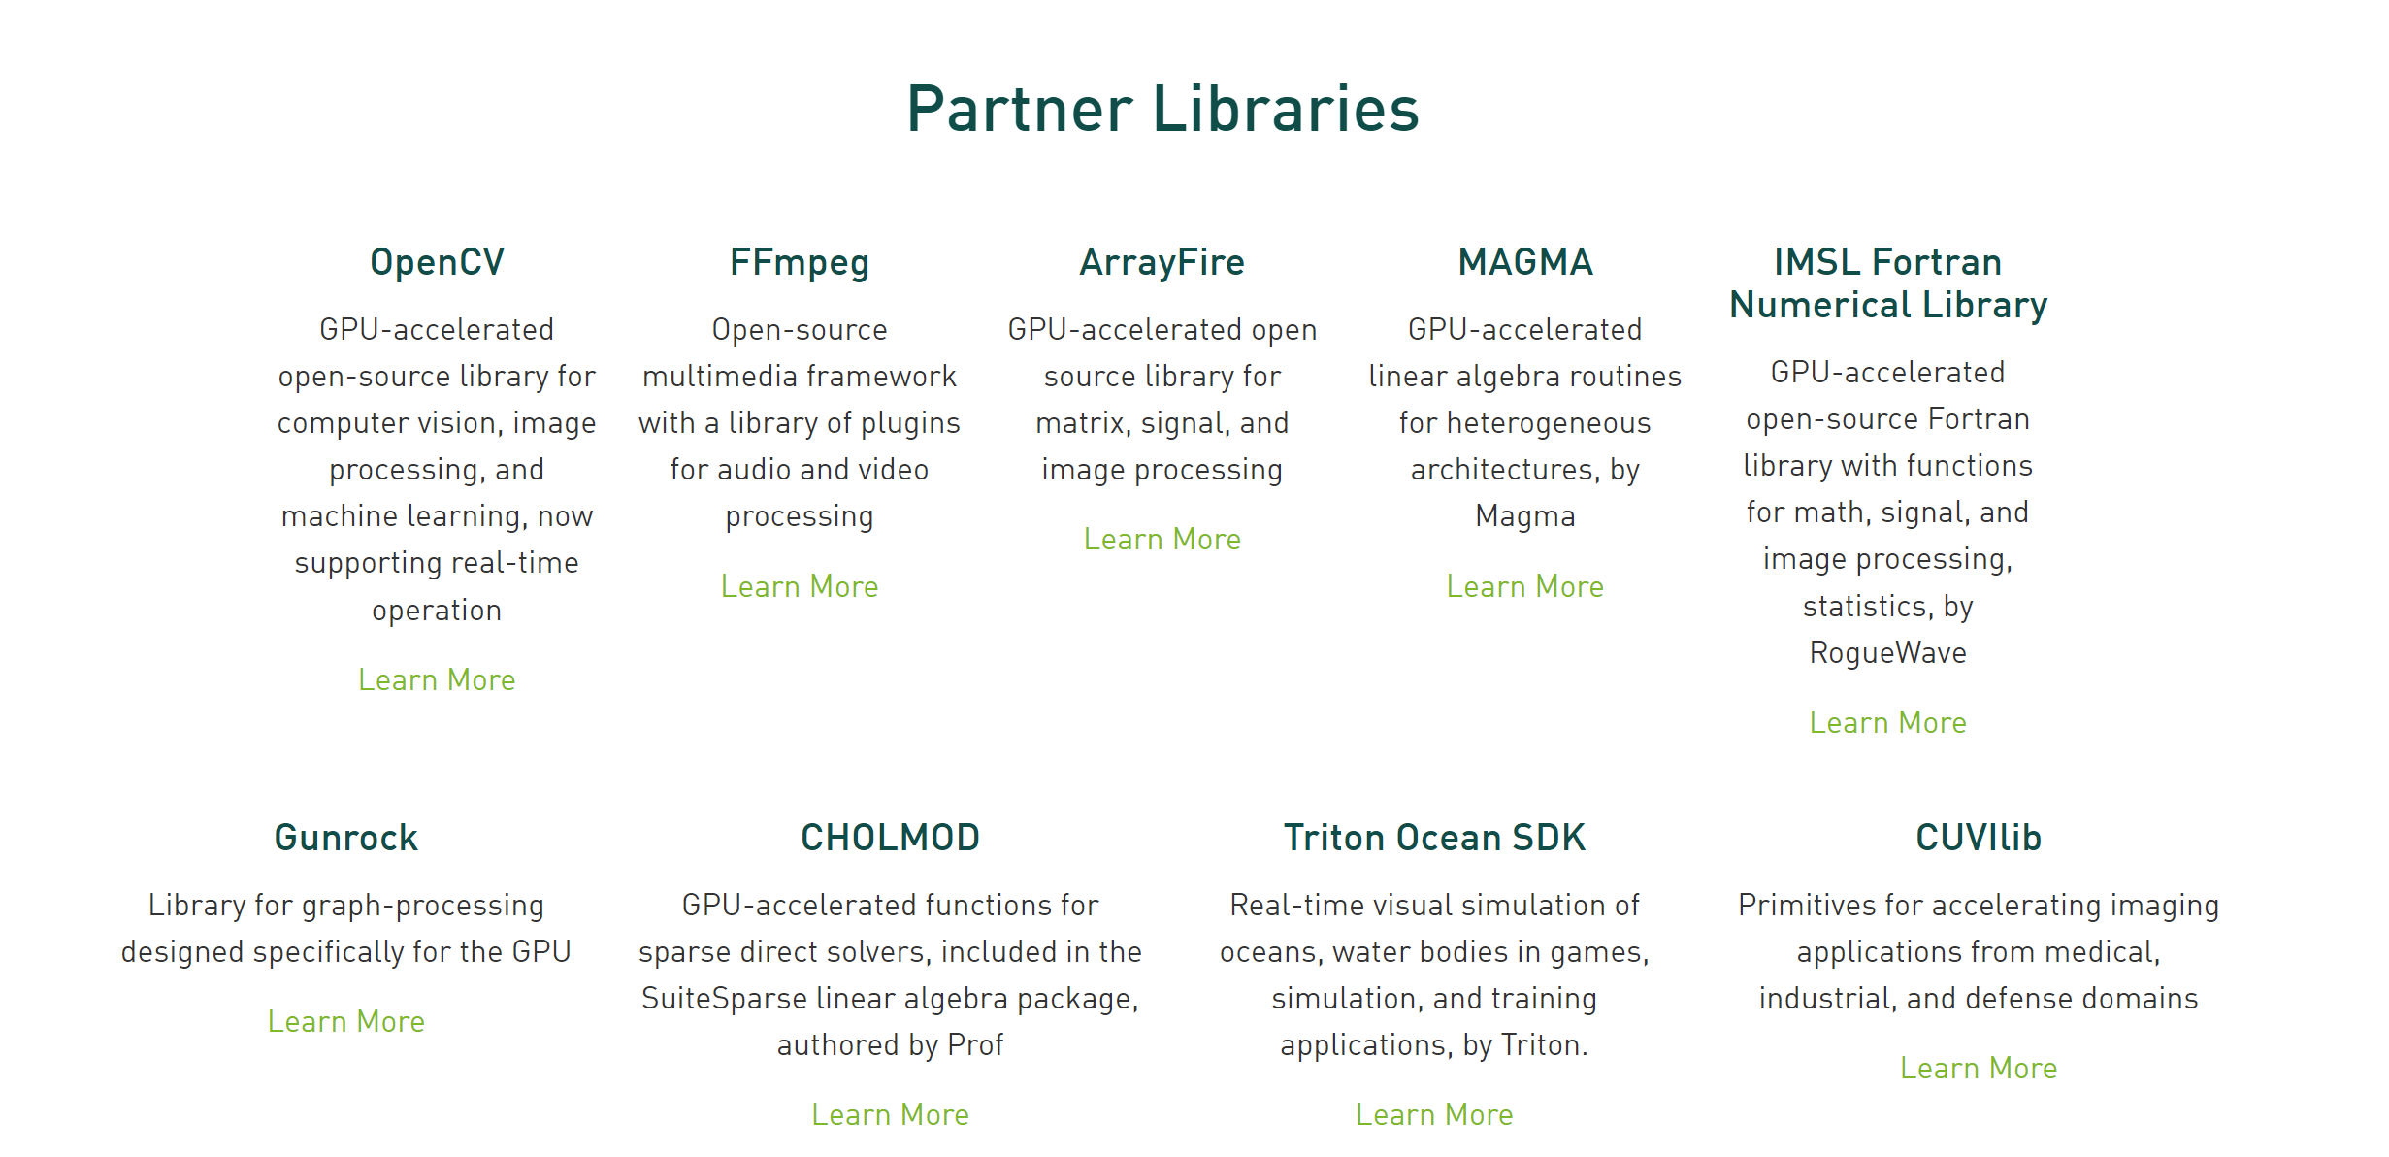
Other GPU Accelerated Libraries to Consider

Slide 207
Recap and Conclusion

Slide 208
Recap
CUDA is great for massively parallel programming
SIMD – “Single Instruction Multiple Data”
Need enough compute to cover memory overhead
Start naïve, then optimize
Be smart about asynchronous ops and memory

Slide 209
What we haven’t covered
Detailed GPU Architecture
Parallelizing Algorithms
Performance optimization
Warp partitioning
Memory coalescing
Shared mem bank conflicts
CUDA Atomics
Advance Memory Ops
Streams
Compute-Copy Overlap
Tools
NVIDIA Nsight Debugger
Compute Profiler
And much more……

Slide 210
Resources
CUDA C Programming Guide
NVIDIA Nsight
Programming Massively Parallel Processors
NVIDIA GTC On-Demand
Thrust
Penn CIS 565
Intro to Parallel Programming CUDA - Udacity
CUDA Education

Slide 211
Pop Quiz

Slide 212
List a few differences between CPU and GPU

Slide 213
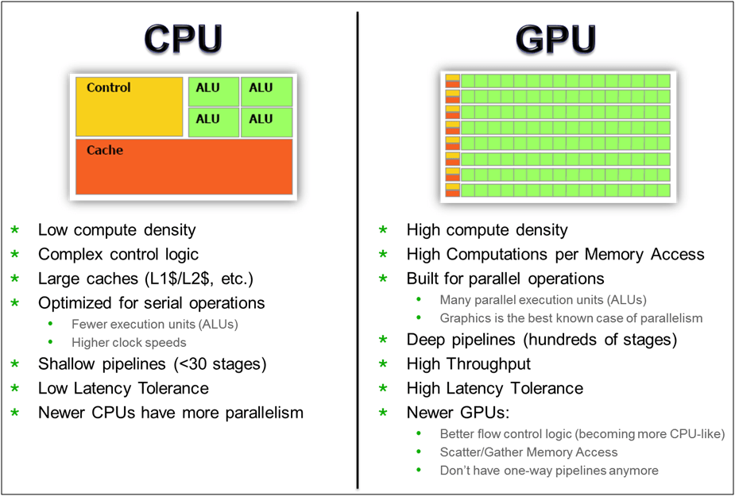
https://www10.mcadcafe.com/blogs/jeffrowe/2017/03/16/the-continuing-importance-of-gpus-for-more-than-just-pretty-pictures/

Slide 214
What are the terms for CPU and GPU used in CUDA?

Slide 215
Heterogenous Computing - Terminology
Host: typically, the CPU
Code written in C/C++ (or other languages)
Device: typically, the GPU (data-parallel)
Code written in extended C/C++
Host and device have separate memories
Except for SoC
CUDA Program
Contains both host and device code
Host
Device

Slide 216
What is the data parallel function in CUDA called?

Slide 217
Heterogenous Computing - Terminology
Kernel: data parallel function
Invoking a kernel creates lightweight threads on the device
Threads are generated and scheduled with hardware
Serial Code
Parallel Code
Serial Code

Slide 218
What is specifier for a kernel?

Slide 219
CUDA Kernels
Executed N times in parallel by N different CUDA threads
// Kernel Definition
__global__ void vectorAdd(const float* A, const float* B, float* C)
Declaration specifier
Notes:
threadIdx is a 3-component vector

Slide 220
What are the levels of logical constructs for parallelism?

Slide 221
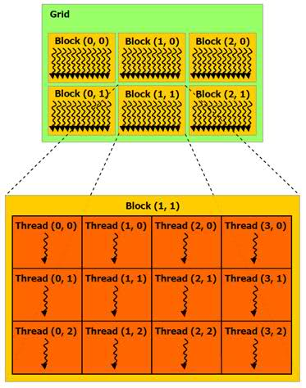
Thread Hierarchies

Slide 222
Thread Hierarchies
Grid – one or more thread blocks
1D, 2D or 3D
Block – array of threads
1D, 2D, or 3D
Each block in a grid has the same number of threads
Each thread in a block can
Synchronize
Access shared memory

Slide 223
How many threads in a block?

Slide 224
1024

Slide 225
What can threads in a block do that blocks in a grid can’t do?

Slide 226
Thread Hierarchies
Image from: http://courses.engr.illinois.edu/ece498/al/textbook/Chapter2-CudaProgrammingModel.pdf

Slide 227
What are the different types of memory on a GPU?

Slide 228
CUDA Memory Transfers
Image from: http://courses.engr.illinois.edu/ece498/al/textbook/Chapter2-CudaProgrammingModel.pdf

Slide 229
What are the built-in variables in CUDA for determining thread ID information?

Slide 230
threadIdx - Index of thread in a block
blockIdx - Index of block in a grid
blockDim - Size of block (No. of threads in a block)
gridDim - Size of grid (No. of blocks in a grid)

Slide 231
What are the ranges of threadIdx and blockIdx?

Slide 232
Range of threadIdx
threadIdx.x = [0, blockDim.x - 1]
threadIdx.y = [0, blockDim.y - 1]
threadIdx.z = [0, blockDim.z - 1]
Range of blockIdx
blockIdx.x = [0, gridDim.x - 1]
blockIdx.y = [0, gridDim.y - 1]
blockIdx.z = [0, gridDim.z - 1]

Slide 233
How to calculate globally unique thread index for 2D block in a 2D grid?

Slide 234
Thread Hierarchies
// Kernel Definition
__global__ void matrixAddition(const float* A, const float* B, float* C,
int N)
{
int x = blockIdx.x * blockDim.x + threadIdx.x;
int y = blockIdx.y * blockDim.y + threadIdx.y;
int idx = y * N + x;
C[idx] = A[idx] + B[idx];
}
int main()
{
// ....
// Kernel invocation with computed configuration
dim3 threadsPerBlock(16, 16);
dim3 blocks(N / threadPerBlock.x, N / threadPerBlock.y);
vectorAdd<<<blocks, threadsPerBlock>>>(A, B, C);
}
2D Thread Index to 1D memory index
16x16 Threads per Block
2D grid of blocks
2D block of threads
Notes:
dim3 default argument is 1

Slide 235
What are the 3 basic CUDA memory API?

Slide 236
CUDA Memory Transfers
cudaMalloc()
Allocate global memory on device
cudaFree()
Frees memory
cudaMemcpy()
Copy memory
Image from: http://courses.engr.illinois.edu/ece498/al/textbook/Chapter2-CudaProgrammingModel.pdf

Slide 237
What are the different direction of memory copy using CUDA API?

Slide 238
CUDA Memory Transfers
cudaMemcpy() - Memory transfer
Host to host
Host to device
Device to host
Device to device
Host
Device
Global Memory
cudaMemcpy(destPtr, sourcePtr, size cudaMemcpyDeviceToHost);
Destination
Source
Copy direction

Slide 239
Pop Quiz for me?

